Slide 1
Guest Feedback Insights
A collaboration Project with SDC(Sentosa Development Corporation)

Slide 2
Project Stakeholders and Key Personnel
Republic Polytechnic
SDC (Sentosa Development Corporation)
Seow Khee Wei (Overall Capstone Project Supervisor)
Koay Seng Tian (Project Supervisor)
Timothy Liu (Nvidia, Project team advisor)
Alfred Tan
Odelia Tan
Luqman Hakim Bin Abdullah
Gina Ng
Kelvin Thor
Kelly Wong (Director Data Analytics)
Adeline Wong (Asst. Director Data Analytics)
Suhas Awasthi (Sn. Asst. Director, Data Architecture & Engineering)
Aileen Kwok (Senior Manager, Corporate planning)
Fu Zi Xiang (Assistant Director, Data Engineering)
Notes:
Explain Project stakeholders and key personnel involvement

Slide 3
What are we looking for?
Mainly the Feedback from Asian language speakers' visitors of Sentosa
But where?
From the publicly available information on the internet
What kind of feedback?
Feedback regarding the locations and experiences visited E.g., Restaurants, hotels, Parks, Attractions etc.
How do we derive Insights from this feedback?
With assistance of various AI NLP (Natural Language Processors) models
Notes:
Has animation. Quickly run through scope.
Bahasa Indonesia was chosen

Slide 4


Platforms or Web portals with Visitor feedback
Social Media
Review Websites
Notes:
Explain areas on internet that has user feedback

Slide 5
Which social media platform do we use?
Naturally, it will be optimal to use all of them
We will first explore what we information we can gather from each platform
And by process of elimination, we will use the most optimal platform
Notes:
Has animation. Quickly run through scope.

Slide 6


Diving into Social Media
Instagram
Is a more photo centric social media platform
the average character count per user’s post is about 130-150
META(Facebook)
User posts are more text centric as photos are more commonly posted into 1 post for separation
The average character count per post is about 80-100
Notes:
Explaining the kind of posts , content and user engagement.
Explain that Instagram users tend to use less text because of how Instagram show the post
Facebook deals with photos differently

Slide 7


Diving into Social Media
Tiktok
Video centric social media platform
Posts often have less than 40 characters or do not even include any text
Twitter
Very text centric Social Media platform
There are 2 common lengths of tweets. Very short tweets about 28 characters
The other common tweet length is about 140 character which was twitter initial character limit
Notes:
Explaining the kind of posts , content and user engagement.
Explain that Tiktok is self explanatory
Tweets either very short 28 characters or around 140 characters

Slide 8
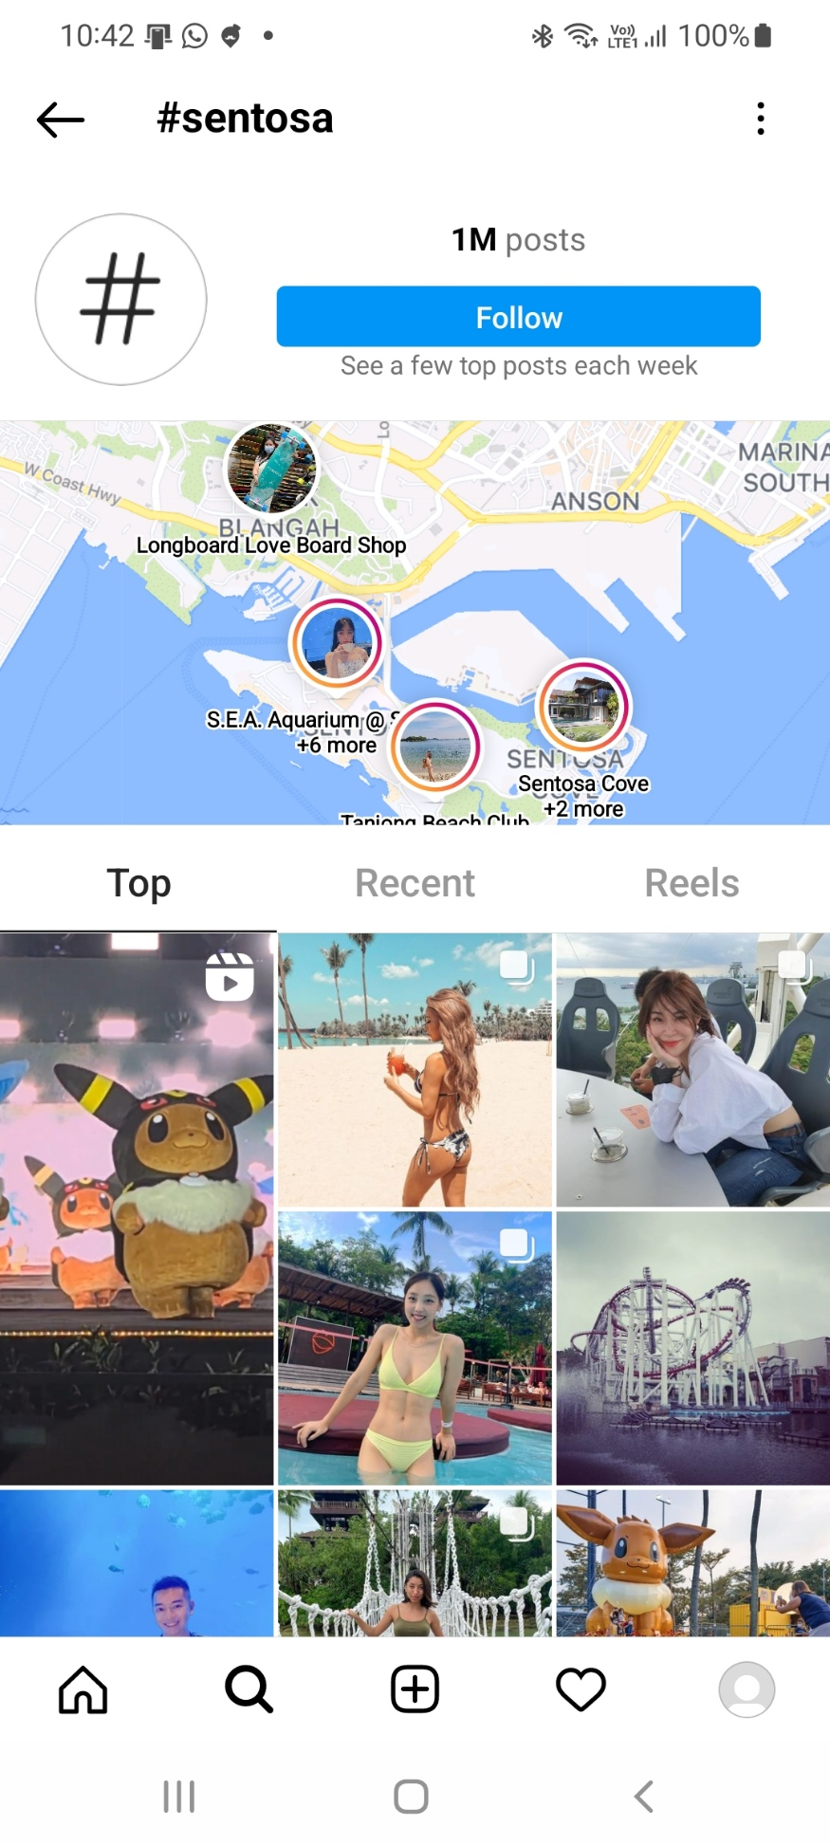
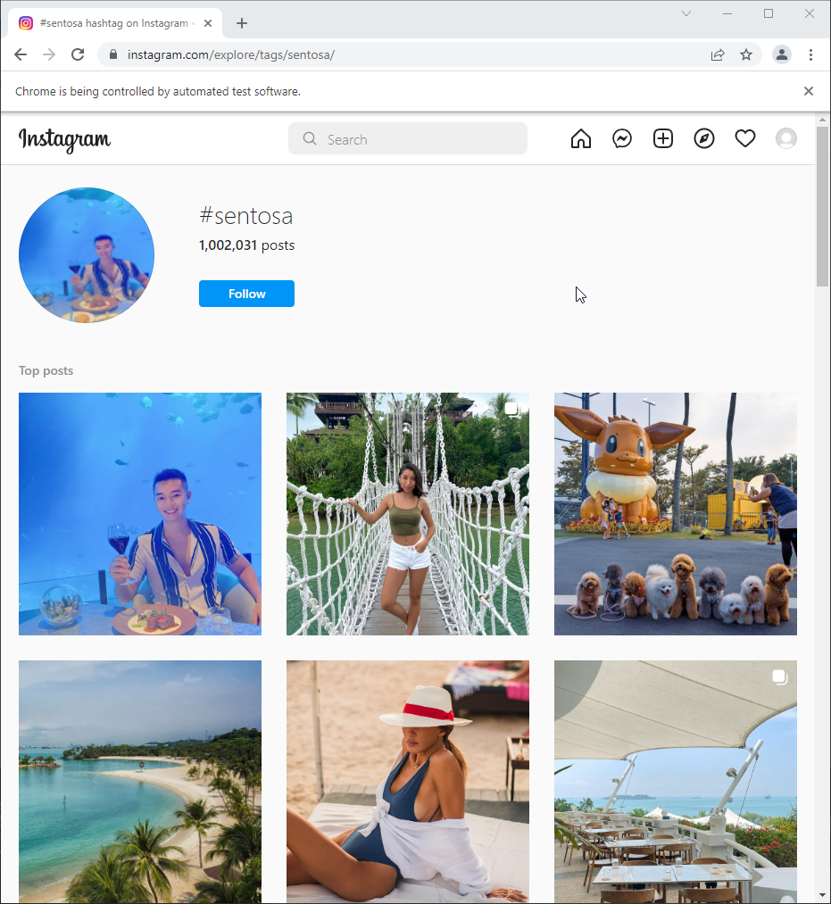
Instagram
Notes:
Photo centric
Very basic search function

Slide 9
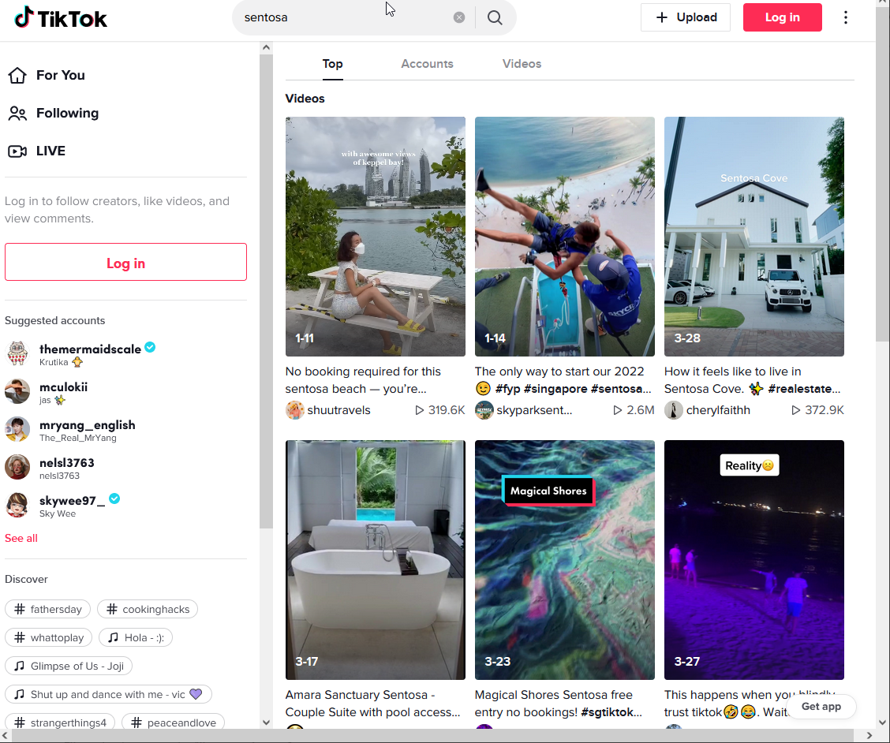
Tik Tok
Notes:
Video centric
Very basic search function

Slide 10
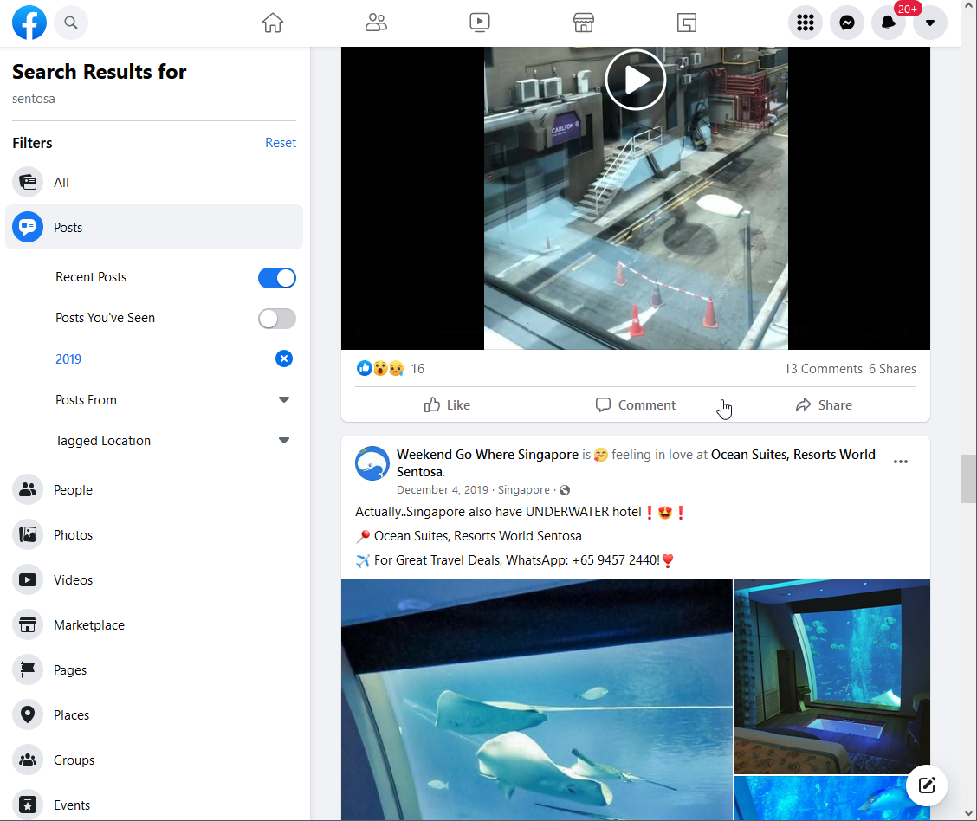
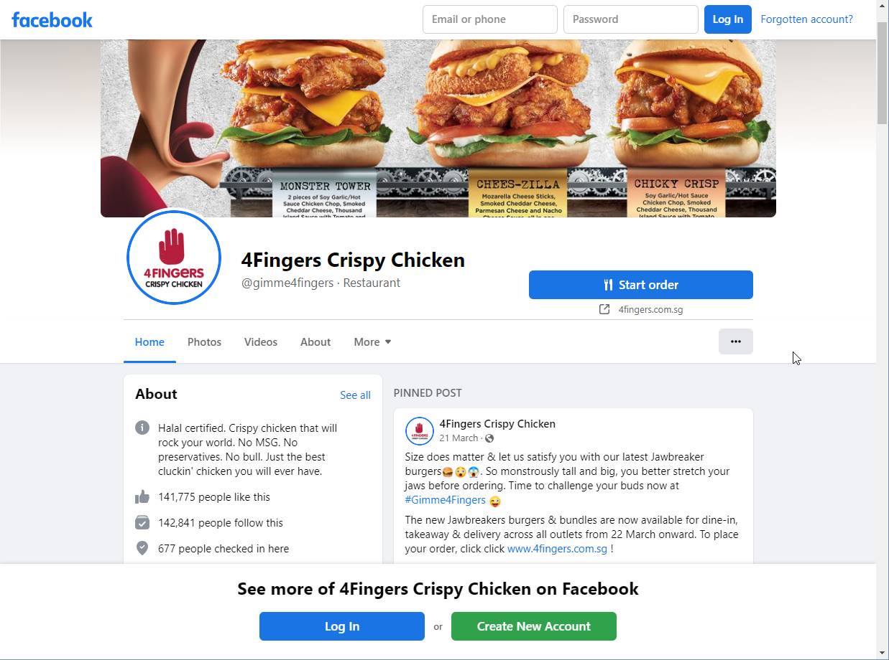
Facebook
Notes:
Searching by posts only show posts that users select that are publicly available. Amount of data available is very limited

Slide 11
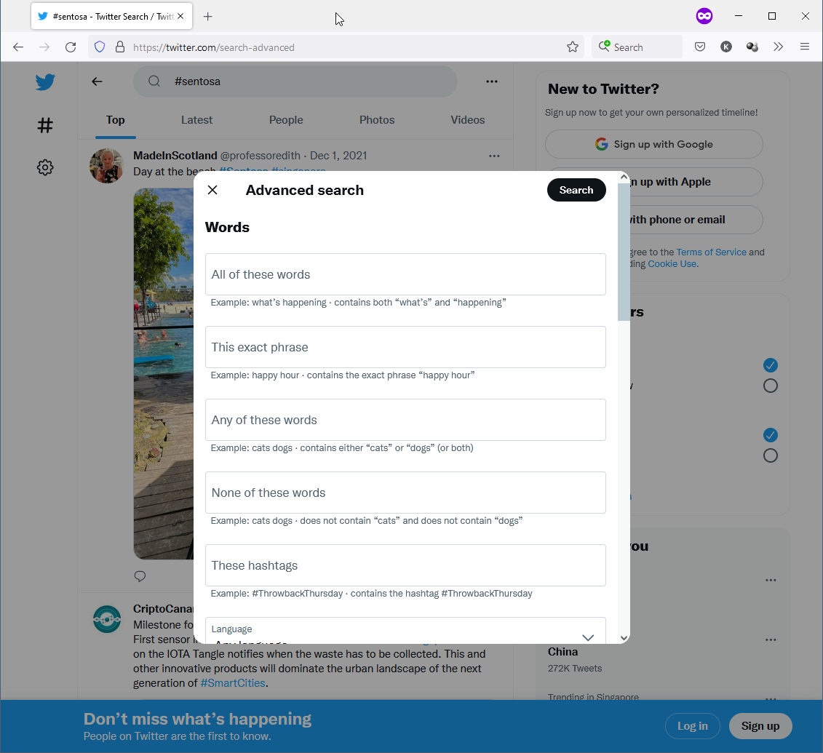
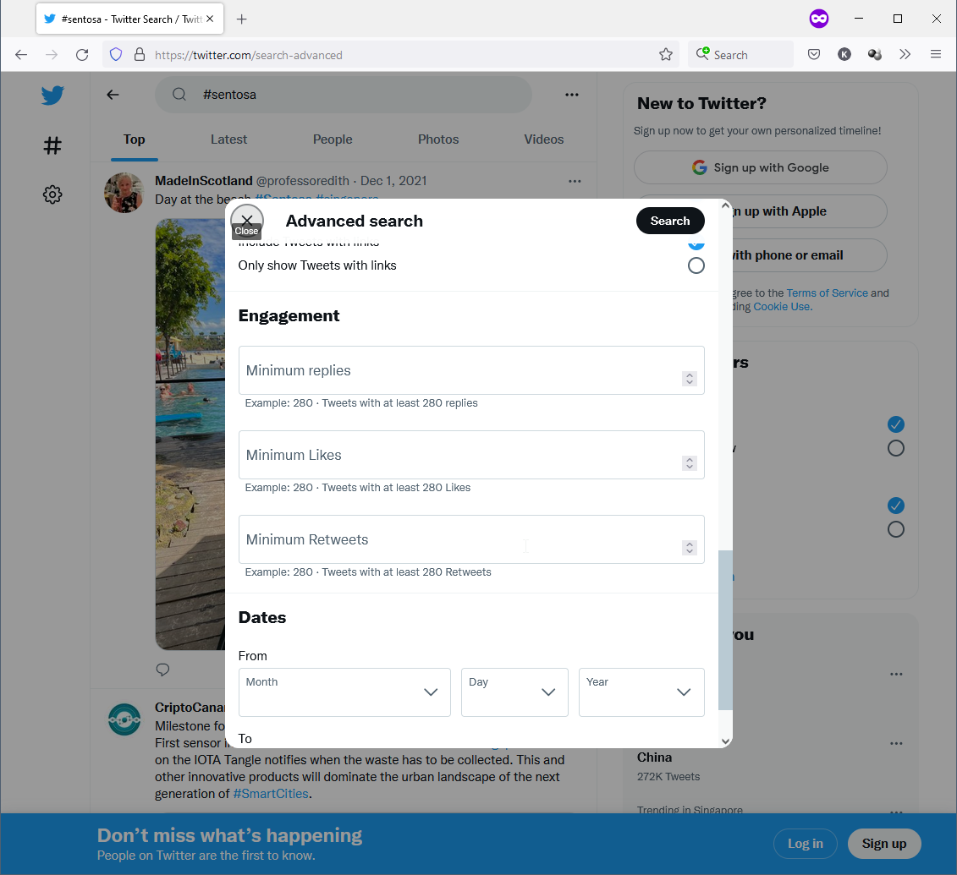
Twitter
Twitter was chosen by process of elimination
Notes:
Explain the robust user search and API available

Slide 12
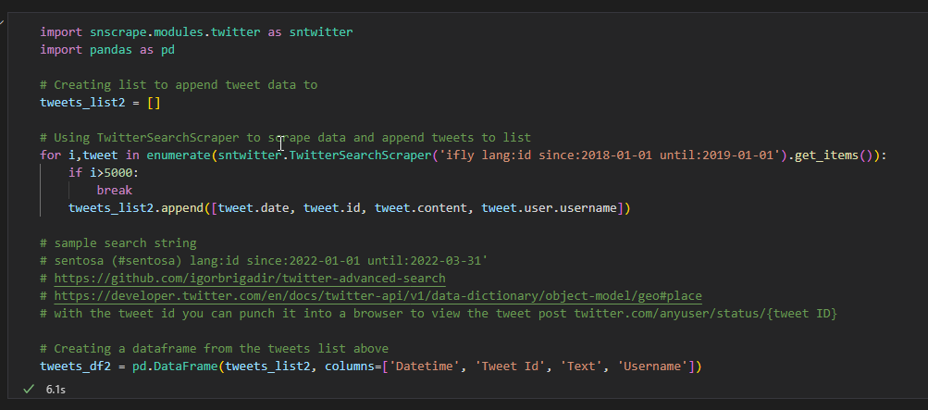
Grabbing available data from Twitter

Slide 13
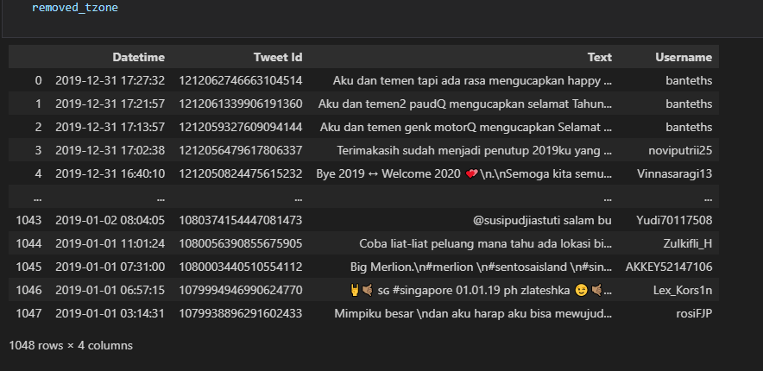
Grabbing available data from Twitter

Slide 14
Issues when using keywords / generic hashtags to gather data

Slide 15
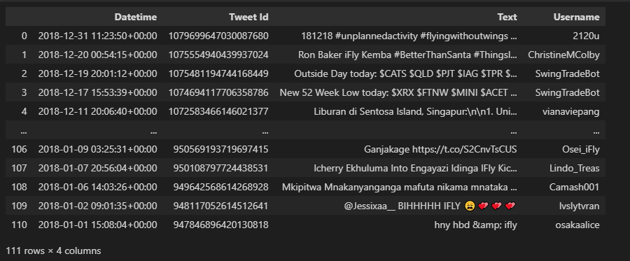
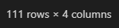
Low number of results

Slide 16
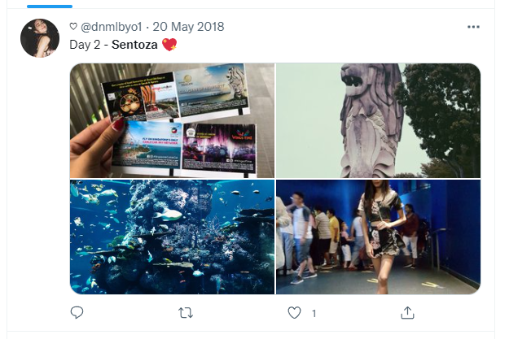
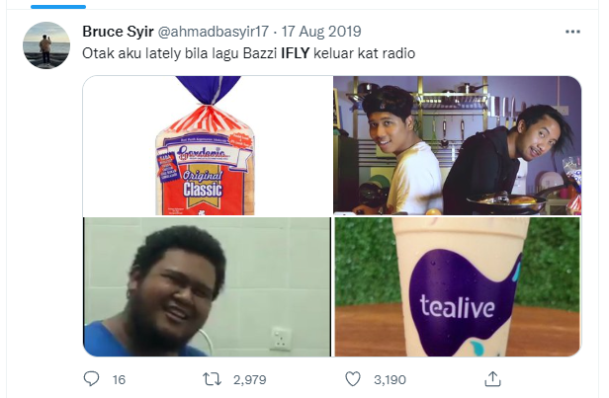
Incorrect spellings or unrelated tweets
Notes:
Show that tweets can be difficult to search
Internet slangs like “Netflix and chill”

Slide 17
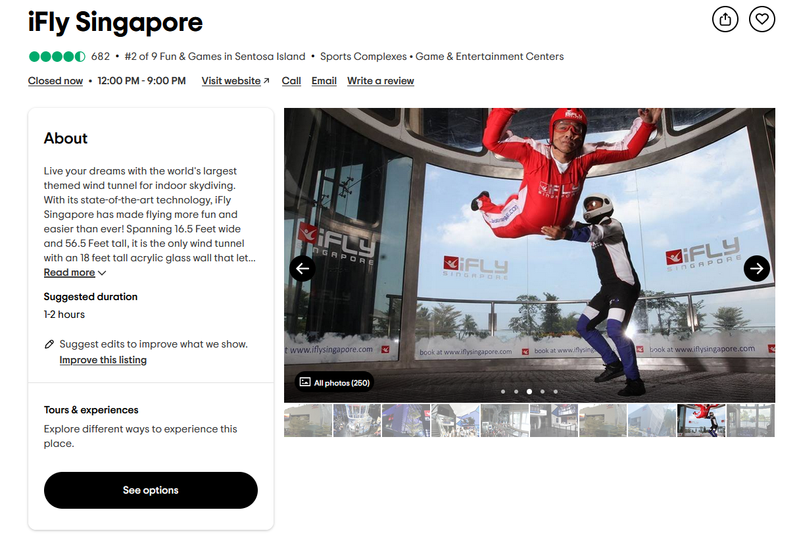
Notes:
ifly reference

Slide 18
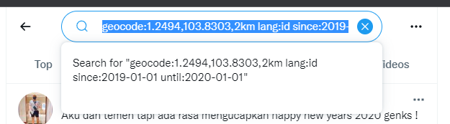
Filter the search by Geolocation tagged tweets
Notes:
Resolved by using geolocation tagging
Talk about the code. Note that full explanation on breakdown how we do it. Let luqman explain fully on his part.

Slide 19
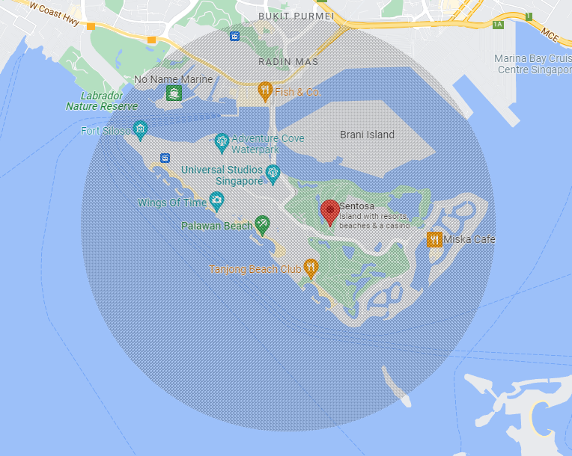
Notes:
Reference for geolocation code. Show only if needed.

Slide 20
Insights from Twitter
Strengths
Visitors are quick to talk about their experience on twitter so feedback can be quickly gathered for analysis for a quick overview of positive or negative consensus with the public
Weakness
As each tweet is too short to perform further analysis for better insights

Slide 21
Lacking available Asian language NLP models
There are about 600 models on hugging face for English NLP Sentiment Analysis
For Bahasa Indonesia, there less than 10 available on hugging face

Slide 22
#2 Luqman Hakim Bin Abdullah
Travel Reviews Sentiment Analysis
Notes:
All details were presented weekly & emailed 2022 March 21st till end-June

Slide 23




Web Scrapping

Slide 24
Web Scrapping
Website | Challenges | Solutions attempted | Tools/Libraries Used
TripAdvisor | Extracting Native Reviews | Selecting using XPATH | Selenium DataMiner
Klook | JavaScript Pagination Anti-botting | Rotating random user agent IP Rotation/ Proxy Setting a Referrer Scrape from Google Cache Adding random intervals | BeautifulSoup4 & requests DataMiner
Traveloka | Data stored in API | - BeautifulSoup4 & Requests | WebScraper.io
Google Reviews | Infinite Scrolling | - Selenium | DataMiner

Slide 25
Extracted Review Output
Date – date of review
User- author of review
Ratings
Review
Page_url – Link where review was extracted
Attraction
Source – Website

Slide 26
Normalizing Raw Data
Date extracted in various format
Proper date – 10 December 2020
English abbreviated date – 10 Dec 2020
Foreign abbreviated date – 10 Des 2020
String as date – A month ago, 2 years ago
Missing day – Dec 2020
Ratings extracted in various format
1-5
1-10
‘Baik’ as 4
‘Sangat Direkomendasikan’ as 5
“5,0 dari 5 lingkaran”
“Diberi rating 5,0 dari 5”
Only extracted year
Ratings normalized to 10

Slide 27
Sentiment Pre-processing
Case Folding
Demoji and Translate to Bahasa Indonesia
Remove punctuation and symbols
Fix slang words
Stop word Removal
Stemming
Text summarization

Slide 28
Demoji and translate
Python libraries
Emot
SpaCy
Google Translator
Emot to create dictionary of emojis/emoticons to its’ respective English alias
SpaCy to tokenize - spacy.blank('id’)
Google Translator to translate to Bahasa Indonesian

Slide 29
Demoji and translate
😄
“smiling face with open mouth and smiling eyes”
“wajah tersenyum dengan mulut terbuka dan mata tersenyum”
:-)
“smiley”
“tersenyum”

Slide 30
Remove Punctuation and Symbols
Remove noise for the sentiment model
Usage of regular expression
Replaced any character NOT a-z, A-Z or 0-9 with an empty space
str.replace('[^\w\s]','',regex=True)

Slide 31
Fix Slang Words
Slang word list is in lowercase
Used to change users’ slang words into proper words
Custom Bahasa Indonesian slang word list from louisowen6/NLP_bahasa_resources
Added more slang words to cover as much edge cases as possible
dtg
datang

Slide 32
Text Summarization
Azure Cognitive Service for Language
Google Cloud Platform
HuggingFace Text Summarization
cahya/t5-base-indonesian-summarization-cased
Finetuned using id_liputan6 dataset
Max 512 tensor size for sentiment models
Lowest number of characters for Indonesian/Malay is 3
512 x 3 = 1536 characters maximum for summarization
Ref: https://brunei-linguistics.blogspot.com/2017/08/word-length-in-malay-and-english.html

Slide 33
Stemming + Removal of Stop words
membeli
beli
Stemming
Stemming Sastrawi Python library
To remove data redundancy
Stop Words
To give more focus to the important information in the review
Custom Bahasa Indonesian stop words list from louisowen6/NLP_bahasa_resources GitHub Repository
Additional stop words from “countwordsfree.com/stopwords”
Combined with SpaCy’s “en_core_web_lg” built-in stop words

Slide 34
Sentiment Analysis
Help to gain insights from negative and neutral reviews using keywords, bigrams and trigrams
Attraction sentiment over the years
Positive – Enthusiastic, happy or excited
Neutral – Seems satisfied but don’t express particular feeling
Negative – Angry, annoyed or frustrated

Slide 35
Validating Sentiment Models
Random 50 reviews generated using Pandas “.sample()” method to self-label and pre-processed
3 HuggingFace Models
Google Cloud Platform Sentiment Model
Metric Aim:
Willing to accept False Negatives and False Neutral
Capture as much potential Neutral or Negative reviews to help gain insights to improve attraction
High recall for Neutral and Negative

Slide 36
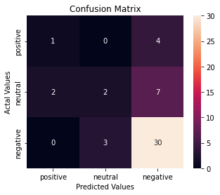
Validating Sentiment Models
sahri/indonesiasentiment
RoBERTa Base Sentiment Classifier
Trained on OSCAR dataset (Huge multilingual corpus)
Fine-tuned on indonlu’s SmSA dataset consisting of Indonesian comments and reviews
Overall Accuracy: 67%
Sentiment | Precision | Recall
Positive | 33% | 20%
Neutral | 40% | 18%
Negative | 73% | 91%

Slide 37
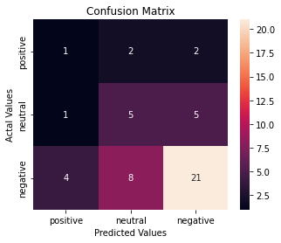
Validating Sentiment Models
ayameRushia/bert-base-indonesian-1.5G-sentiment-analysis-smsa
BERT Base Sentiment Classifier
Trained on Indonesian Wikipedia and Indonesian newspapers
Fine-tuned on indonlu’s SmSA dataset consisting of Indonesian comments and reviews
Overall Accuracy: 55%
Sentiment | Precision | Recall
Positive | 17% | 20%
Neutral | 33% | 45%
Negative | 75% | 64%

Slide 38
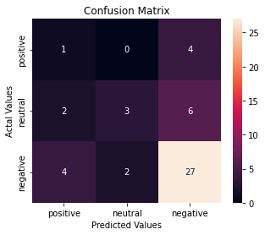
Validating Sentiment Models
tyqiangz/indobert-lite-large-p2-smsa
BERT Base Sentiment Classifier
IndoBERT – Indonesian version of BERT Model
Trained on Indonesian Wikipedia, news articles and Web Corpus (Total 220M words)
Fine-tuned on indonlu’s SmSA dataset consisting of Indonesian comments and reviews
Overall Accuracy: 63%
Sentiment | Precision | Recall
Positive | 14% | 20%
Neutral | 60% | 27%
Negative | 73% | 82%

Slide 39
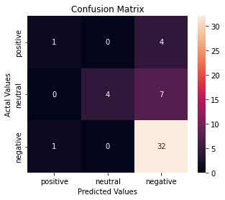
Validating Sentiment Models
Google Cloud Natural Language API
Overall Accuracy: 76%
Sentiment | Precision | Recall
Positive | 50% | 20%
Neutral | 100% | 36%
Negative | 74% | 97%

Slide 40
Validation Overview
Model | Accuracy | Positive Precision | Positive Recall | Neutral Precision | Neutral Recall | Negative Precision | Negative Recall
sahri/indonesiasentiment | 67% | 33% | 20% | 40% | 18% | 73% | 91%
ayameRushia/bert-base-indonesian-1.5G-sentiment-analysis-smsa | 55% | 17% | 45% | 33% | 45% | 75% | 64%
tyqiangz/indobert-lite-large-p2-smsa | 63% | 14% | 20% | 60% | 27% | 73% | 82%
Google Cloud Platform Language API | 76% | 50% | 20% | 100% | 36% | 74% | 96%

Slide 41
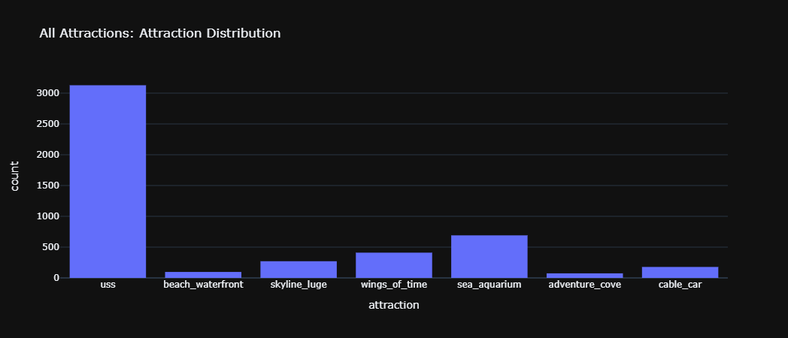
Attraction Review Count Distribution

Slide 42
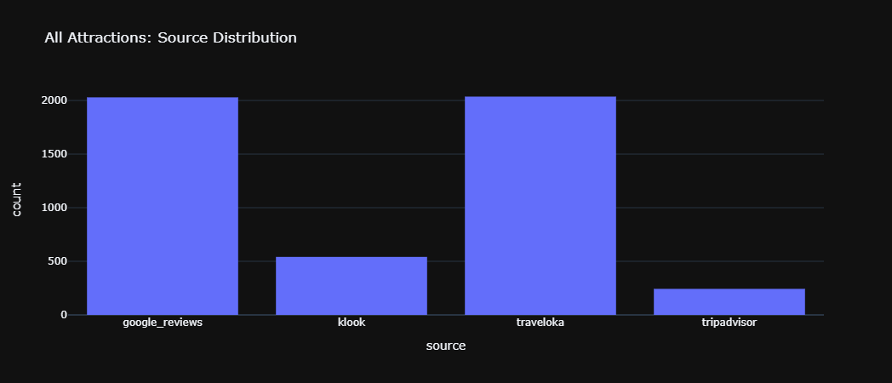
Source Distribution

Slide 43
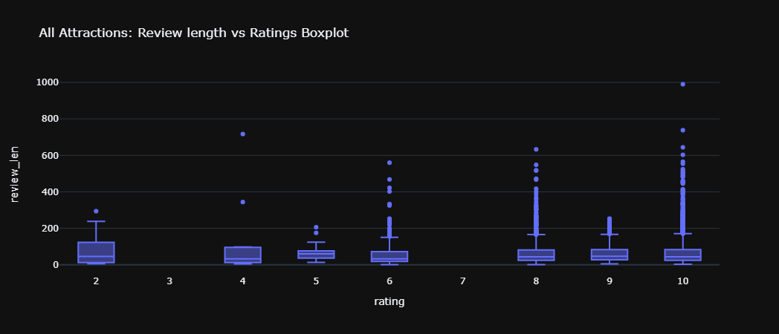
Review Length vs Sentiment Boxplot

Slide 44
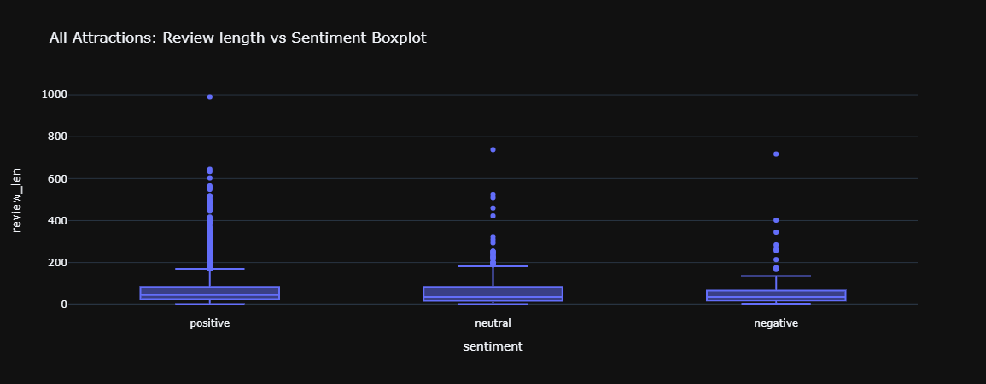
Review Length vs Sentiment Boxplot

Slide 45
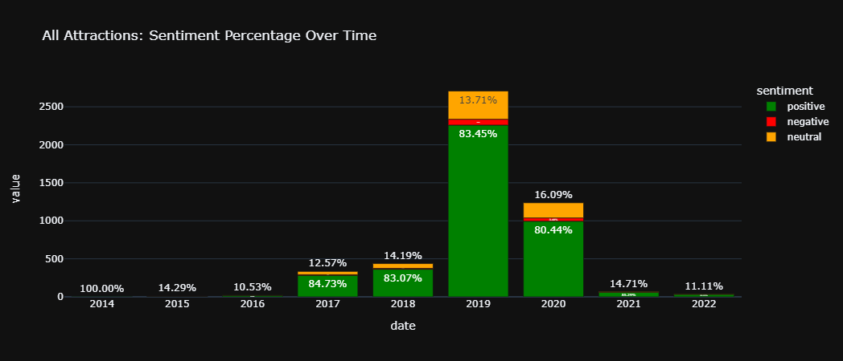
Overall Sentiment Over Time

Slide 46
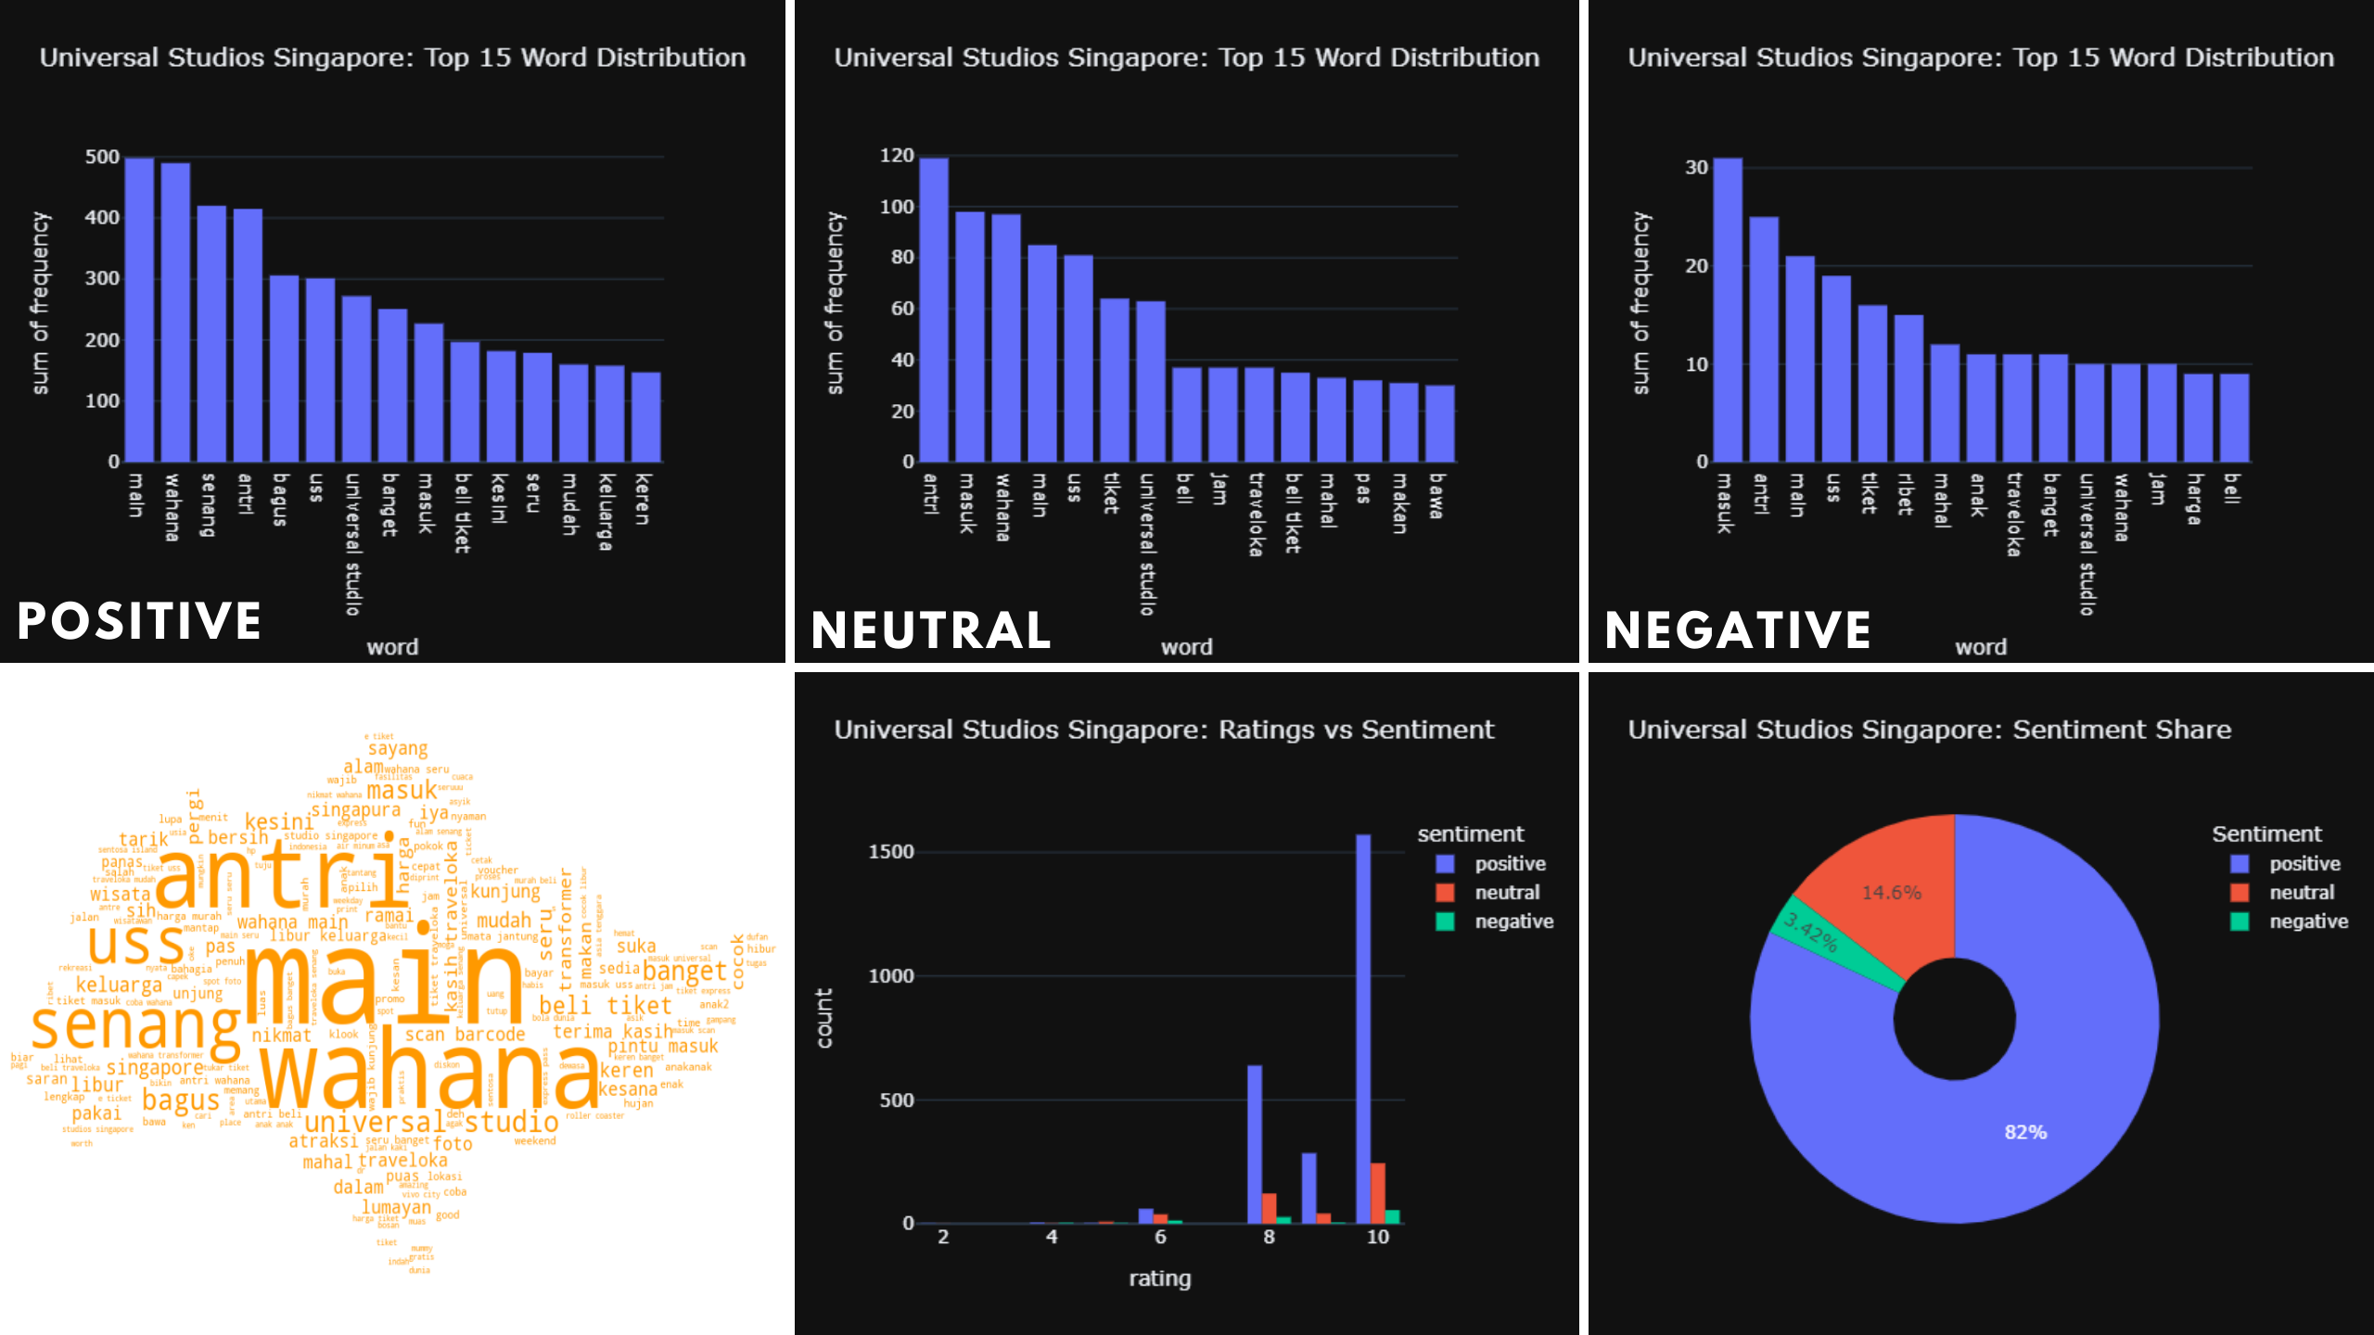
USS Visualizations

Slide 47
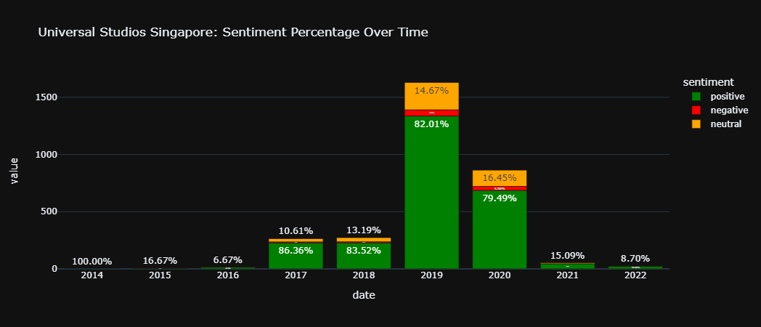
USS Sentiment Over Time

Slide 48
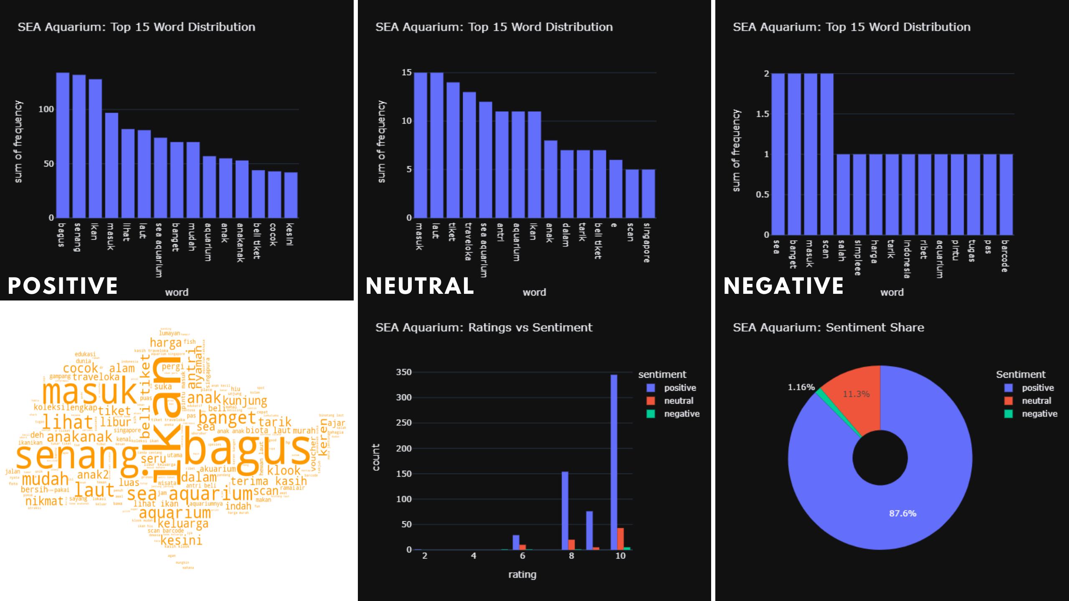
SEA Aquarium Visualizations

Slide 49
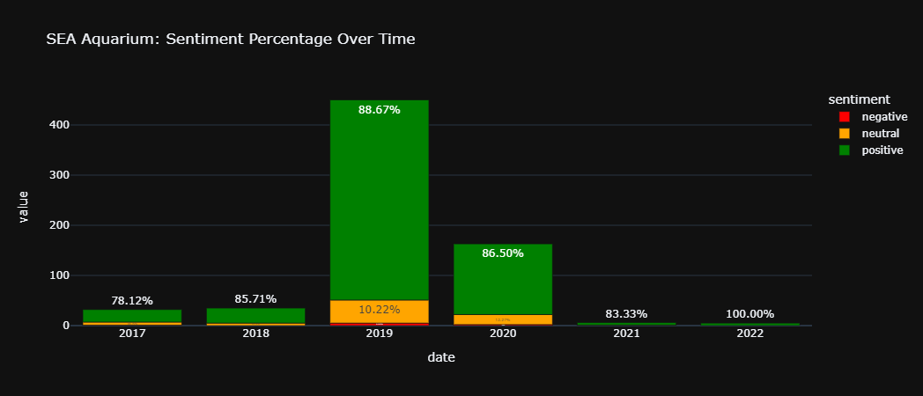
SEA Aquarium Sentiment Over Time

Slide 50
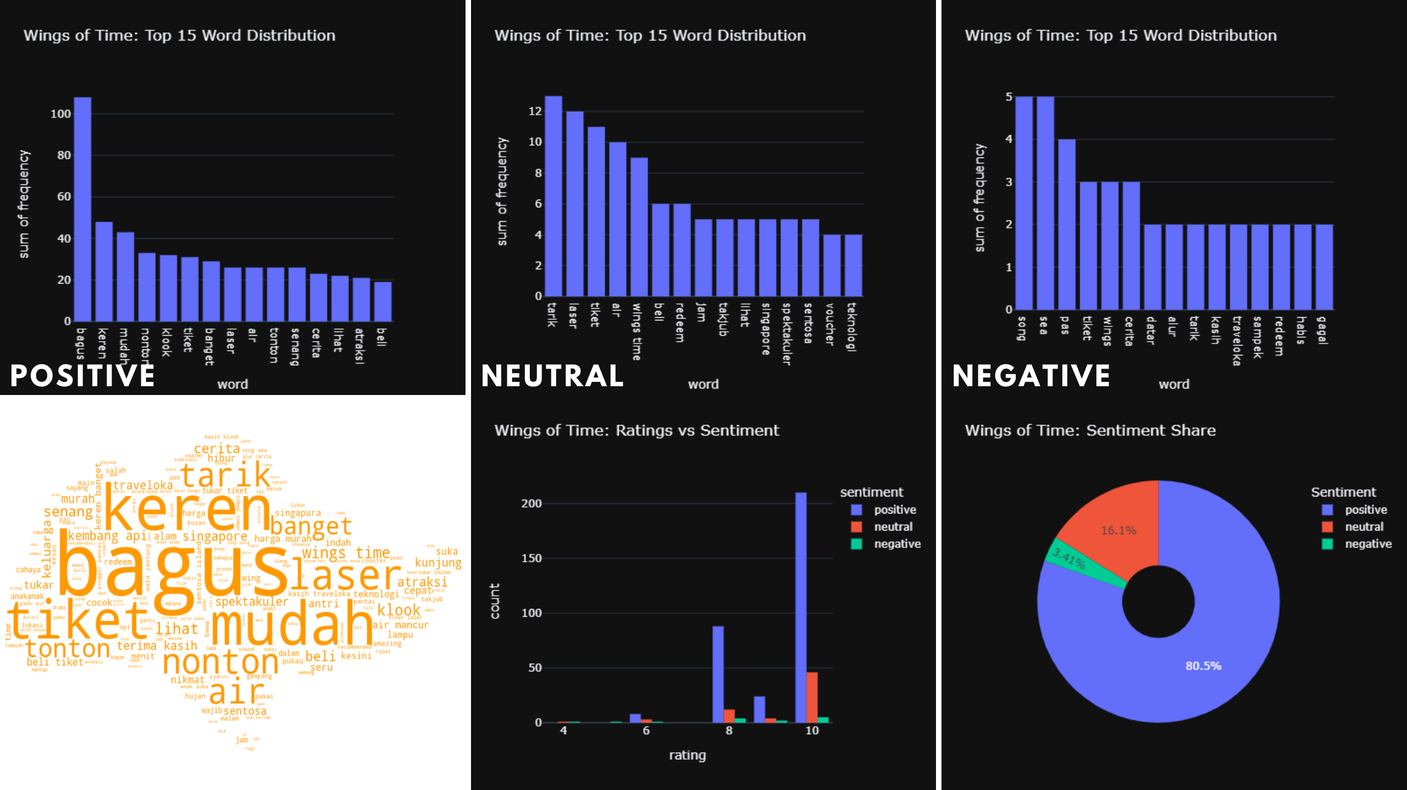
Wings of Time Visualizations

Slide 51
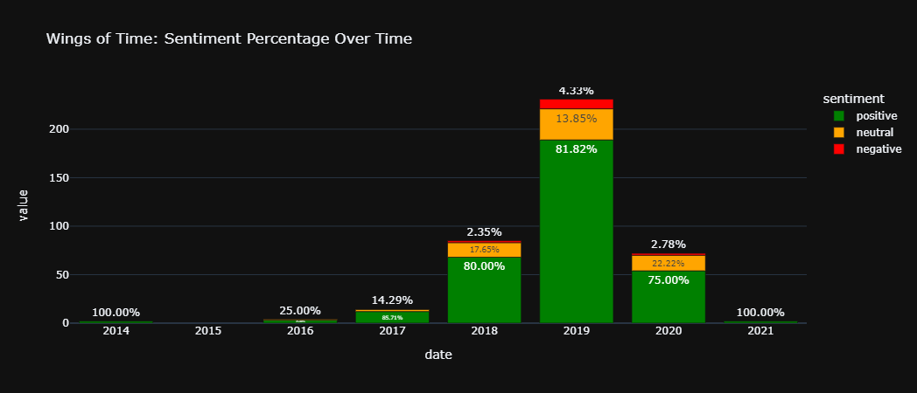
Wings of Time Sentiment Over Time

Slide 52
Moving Forward
Create and deploy dashboard using Plotly + Dash for interactive dashboards
No hyperparameter tunings for pre-trained models
Azure AutoML
Manually sentiment label 500-1000 reviews
80% for training data, 20% for validation data
Train to classify sentiment based on training data

Slide 53
#3 Gina Ng
Market Research / Data Collection / Travel Reviews / Hotels & Dining
Notes:
All details were presented weekly & emailed 2022 March 21st till end-June

Slide 54
Market Research
Preliminary background understanding of the FOUR (4) listed targets: India, Malaysia, China, Indonesia
for native local languages that’s NON-english
Notes:
SDC’s current textual analysis capabilities is for local market share in Singapore limited to English. India, Malaysia, China, and Indonesia are among the top countries where recent visitors originate from.

Slide 55
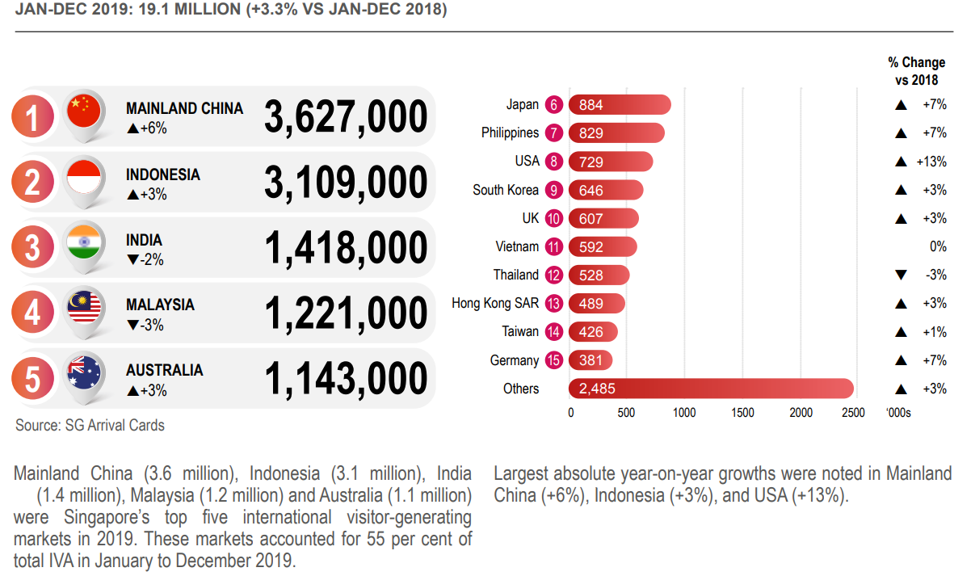
stb.gov.sg/content/dam/stb/documents/statistics-marketing-insights/Quarterly-Tourism-Performance-Report/STB%20Q4%202019%20FA%20v7.pdf
Notes:
This joint project collaboration focused on Bahasa Indonesia for fifteen (15) weeks of industrial engagement due to four (4) key considerations:
Singapore Tourism Board (STB) 2019 registered 3.11m Indonesian tourism compared to China 3.63m and India 1.42m (Week 1 of 15: 11am Thu 24th March 2022)
Accessibility to China’s tourists dataset is restricted by its ‘Great Firewall’
> CONTINUE third point in next slide …

Slide 56
https://en.wikipedia.org/wiki/EF_English_Proficiency_Index
2021 Rank | Country | 2021 Score | 2021 Proficiency Band
4 | Singapore | 635 | Very High Proficiency
28 | Malaysia | 562 | High Proficiency
48 | India | 515 | Moderate Proficiency
49 | Mainland China | 513 | Moderate Proficiency
80 | Indonesia | 466 | Low Proficiency
Notes:
iii) Indonesia has the lowest proficiency and the least users in English language as of 2021 & significantly much higher usage in their native language (Week 2: 11am Thu 31st March 2022)
Only 29.4% of Indonesia population knows English (‘inggris’)
97% uses Bahasa Indonesian daily
55.17% use only or mostly Bahasa Indonesia (predominately male) https://blog.jakpat.net/language-preference-on-social-media-survey-report/
41.33% use Bahasa Indonesia with other languages (45.81% English) https://www.researchgate.net/figure/Three-most-popular-languages-for-tweets-in-each-top-10-country_fig3_221614740
68.81% use Bahasa Indonesia when writing long post or in a hurry/rushing
Indonesia is the only country in Sentosa’s list of the 4 markets without English listed online https://en.wikipedia.org/wiki/Languages_of_Indonesia
> CONTINUE 4th point in next slide …

Slide 57
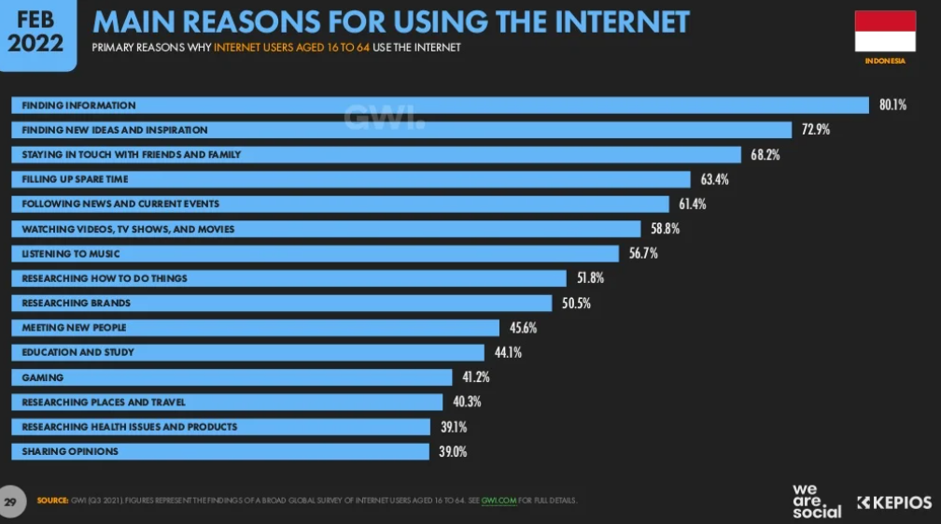
https://datareportal.com/reports/digital-2022-indonesia
Tiktok (22.2 mil) | #4 In Indonesia (#2 globally)
Facebook (176.5 mil) | #1 in Indonesia (#3 globally)
YouTube (139 mil) | #2 in Indonesia (#3 globally)
Instagram (99.15 mil) | #3 in Indonesia (#4 globally)
Twitter (18.45 mil) | #5 In Indonesia (#5 globally)
Notes:
iv) Indonesia consistently ranks within the top 5 countries for the common 5 most popular social media platforms globally https://www.statista.com/markets/424/internet/
191.4 million social media users in Indonesia in January 2022
equivalent to 68.9% of the total population (277.7 million / 4th largest country)
increased by 21 million (+12.6%) between 2021 and 2022

Slide 58
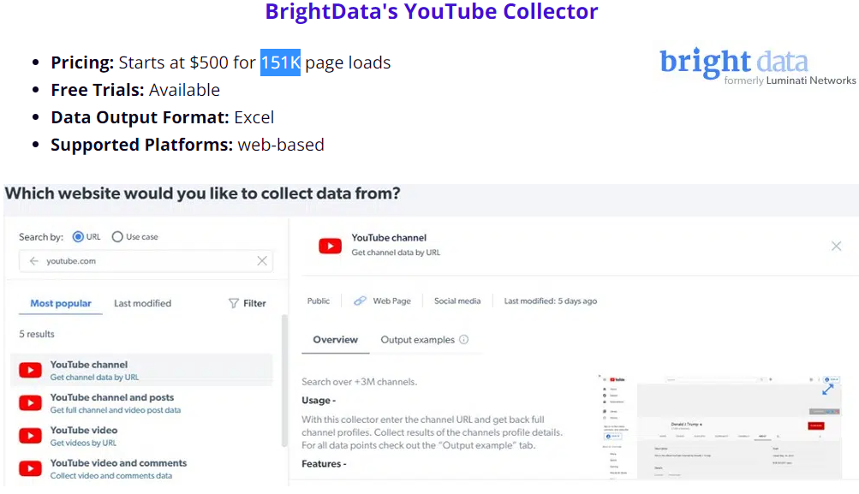
"YouTube provides a very limited option when it comes to accessing specific publicly available data with some restrictions. Usually, if you want to circumvent those restrictions in the right way, you might need to contact them and pay them for it. YouTube does NOT allow accessing its data using a web scraper. They want you to make use of their limited API. YouTube is owned by Google and has one of the smartest anti-scraping systems in place meant for detecting and preventing bot access."
Notes:
Majority of the social media content were audio-visuals e.g. Tiktok, YouTube, Instagram & even Facebook.
Facebook and Instagram are also excluded due to restrictive users’ privacy enforced, so only Twitter remains as one of the predominately text-based data source. (Week 3: 11am Thu 07th April 2022)

Slide 59
Indonesian Top Influencers
ID | Followers | Male / Female | Posts / Likes | Categories | Sentosa / Singapore
79] raffinagita1717 | 60.6M | 36% / 64% | 16K / 40K | 1] Beauty / Fashion 57% 3] Photography 48% 4] Travel / Tourism 46% 5] Entertainment 42% | 0 / 4
100] princessyahrini (Celebrity / Singer 2008-now) | 37.4M | 48% / 52% | 4K / 30K | 1] Beauty / Fashion 59% 2] Travel / Tourism 53% | 1 / 7
110] laudyacynthiabella (Celebrity / Actress 1994-now) | 35.9M | 39% / 61% | 355 / 10K | 1] Beauty / Fashion 67% 4] Travel / Tourism 42% | 0 / 6
153] Jokowi (Politics / President 2014-now) | 45.9M | 57% / 43% | 3K / 218K | 1] Photography 50% 2] Travel / Tourism 48% | 1 / 1
197] natashawilona12 (Celebrity / Model 2008-now) | 35.7M | 46% / 54% | 1K / 722K | 1] Beauty / Fashion 69% 5] Travel / Tourism 42% | 1 / 9
502] cita_citata (Celebrity / R&B Singer 2014-now) | 14.5M | 56% / 54% | 3K / 7K | 1] Beauty / Fashion 63% 3] Travel / Tourism 44% | 0 / 0
620] ayutingting92 (Celebrity / Singer 2006-now) | 44.9M | 38% / 62% | 9K / 103K | 2] Travel / Tourism 57% | 1 / 9
712] titi_kamall (Celebrity / Actress 1996-now) | 12.6M | 36% / 64% | 5K / 16K | 1] Beauty / Fashion 60% 3] Travel / Tourism 48% | 1 / 29
808] jscmila (Celebrity / Actress 2002-now) | 18.8M | 60% / 40% | 1K / 126K | 1] Beauty / Fashion 66% 2] Travel / Tourism 56% | 0 / 4
1544] rantymaria (Celebrity / Actress 2006-now) | 8M | 49% / 51% | 544 / 116K | 1] Travel / Tourism 53% | 0 / 2
B+ Traveloka | 681K | 43% / 57% | 1,691 | 1] Travel / Tourism 73% | 4 / 15
B+ dede inoen | 3.68M |  | 817 / 2,889 | 1] Gourmet 2] Travel | 0 / 5
B+ Hungry Fever | 458K |  | 490 / 6.2K | 1] Gourmet 2] Voyage | 0 / 15
B+ Trevo Indonesia | 29.8k |  | 622 / 997 | 1] Transport | 0 / 5
C+ Kasih Anggara channel | 1.09K |  | 155 | “Singapore holiday activities for Indonesian” | 18 / 130
Notes:
Top Indonesian influencers only generate minimally limited Singapore content and not about Sentosa https://starngage.com/app/id/influencer/ranking

Slide 60
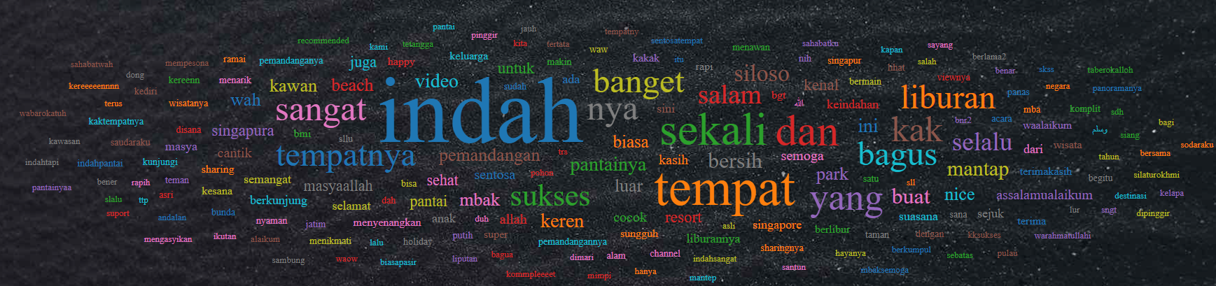
https://youtu.be/HF56-DomhoE 2022 March 09th (294 views) 94 likes 312 comments
"indah" (Bahasa Indonesian detected online Google Translate) : Beautiful
"tempat" (Bahasa Indonesian detected online Google Translate) : Place
Notes:
An example from the more popular YouTube video with higher engagement specific to Sentosa by ‘Kasih Anggara channel’

Slide 61
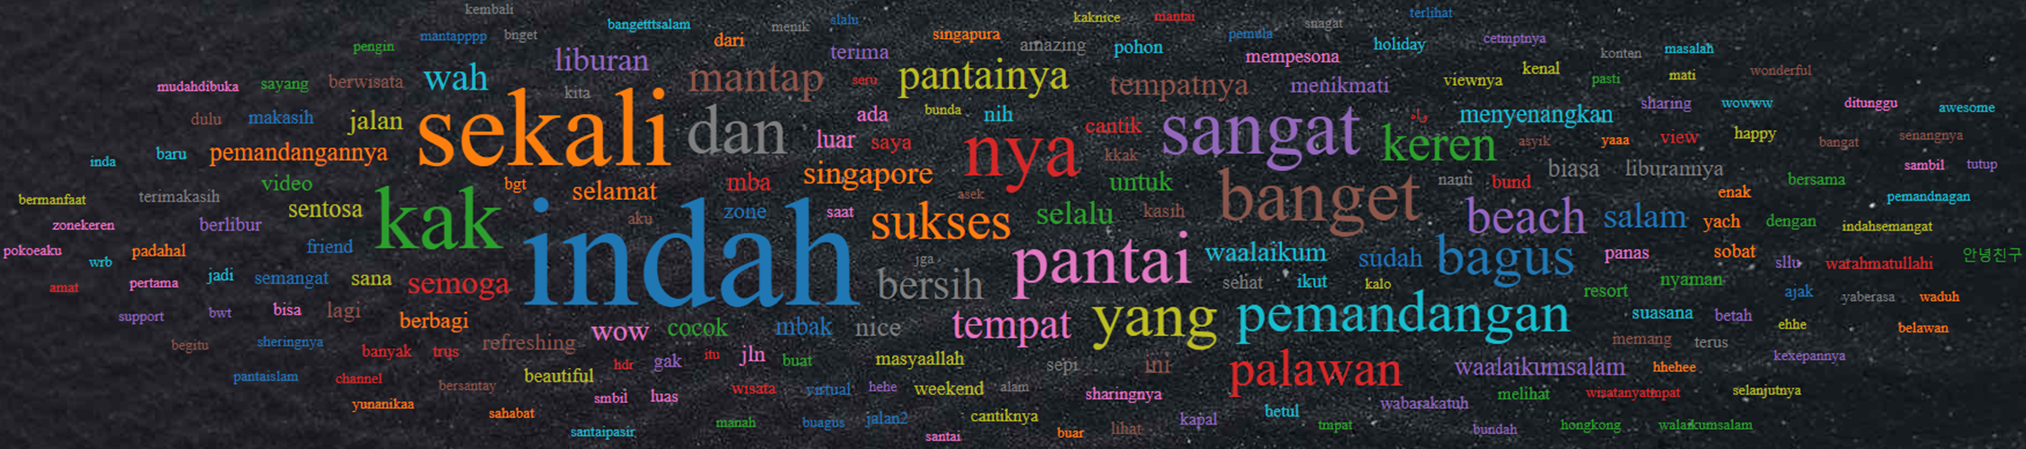
https://youtu.be/ZSam8qi7jm8 2022 March 27th (264 views) 86 likes 259 comments
"sekali" (Bahasa Indonesian detected online Google Translate) : Very
"kak" (Bahasa Indonesian online Google Translate) : Sis
Notes:
Another Sentosa YouTube example from the same creator
The effort to execute thorough data collection online this social media platform is unlikely to extract value with this quick snapshot
Non-optimal effort for questionable value

Slide 62
Data Collection
Overcoming repetitive automation blockage by ‘Bot Detection’
with readily available tools for speed + F.O.C.
Notes:
Travel reviews form the other appropriate channel for relevant data collection, which Traveloka was the top local website for Indonesia.
Proposed duration in two (2) distinct segments:
i) 2018 – 2019 for twenty-four (24) months of normal tourism data prior to Covid restriction (12-months X 2 years)
ii) 2020 – current (2022 May) for twenty-nine (29) months of inactive travel globally

Slide 63
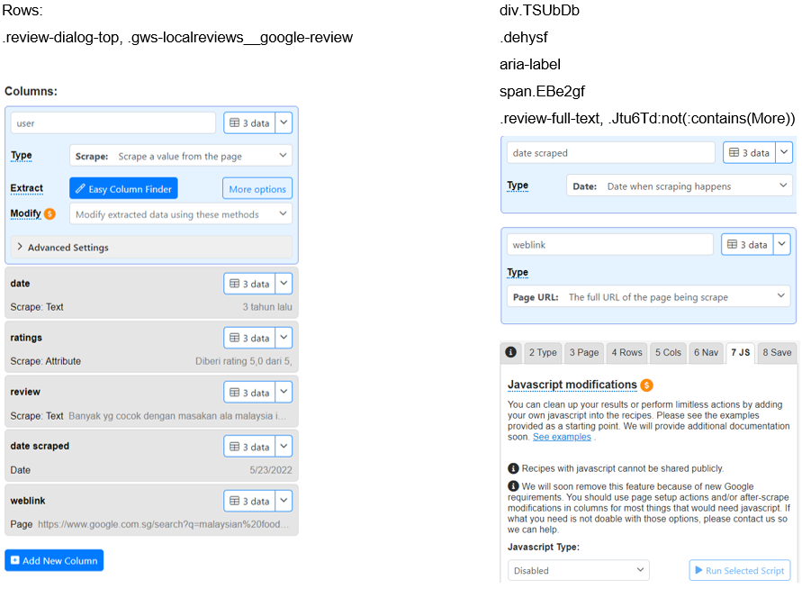
Google - https://dataminer.io/
Notes:
emailed Week 4: 11am Thu 14th April 2022
As summarised by Luqman

Slide 64
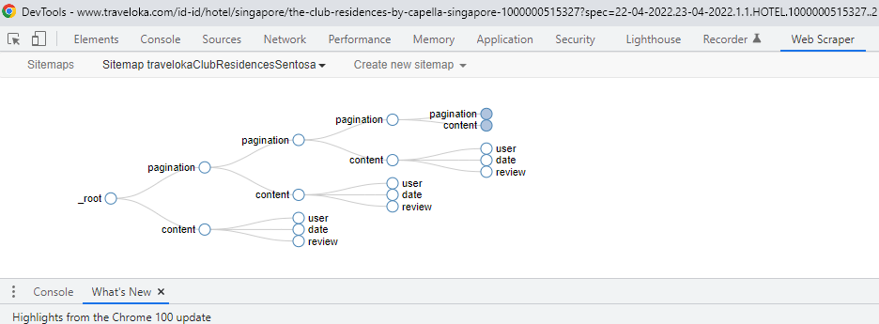
https://webscraper.io/ Traveloka / TripAdvisor / Klook / Tiket
Notes:
Klook blocked the WebScrapper for last two Sentosa hotels ☹

Slide 65
No Indonesia reviews in native language from klook (0%)
Travel Review | Hotel (222) |  |  |  |  | Dining (98)
Traveloka | 117 |  |  |  |  | No F&B category
 | 68 (2018) | 43 (2019) | 6 (2020)
Google | 92 |  |  |  |  | 86
 | 14 (2018) | 36 (2019) | 29 (2020) | 7 (2021) | 6 (2022) | 20 (2018) | 37 (2019) | 25 (2020) | 3 (2021) | 1 (2022)
TripAdvisor | 4 |  |  |  |  | 12
 | 1 (2018) | 3 (2019) |  |  |  | 5 (2018) | 6 (2019) | 1 (2020)
Klook | 0 |  |  |  |  | 0
Tiket | 9 (out of 16 / 7 Inggris reviews) |  |  |  |  | No F&B category
 | 1 (2018) | 7 (2019) | 1 (2020)
36.5%
28.8%
Jan-May
only 5 months
26.8%
Notes:
TripAdvisor reviews are predominantly not originally in Bahasa Indonesia (only 0.2%)
25% of the Indonesia reviews falls into the twenty-nine (29) months from 2020 till May 2022 due to inactive tourism affected by Covid-19 restriction where Singapore imposed strict mandates around mid-April 2020.
Over 41% of this Indonesia reviews is dated from the year 2019 while 2018 is about 34%

Slide 66
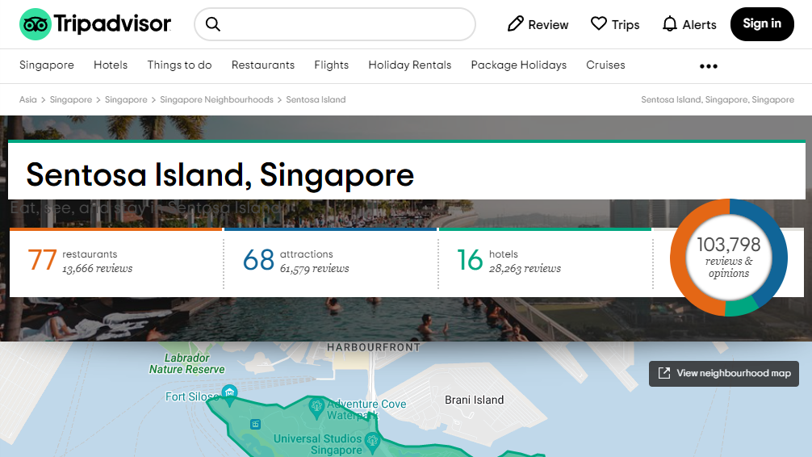
Patrons wrote more than double the quantity of reviews for ACCOMMODATIONS than dining
58% of the travel reviews are for ‘Attractions’ but barely 13% for ‘Dining’.
Notes:
Accommodations reviews (27%) are more than double in quantity than dining, despite almost half of the listings (approximately 48%) online travel websites are for F&B (Week 9: 11am Thu 19th May 2022)

Slide 67
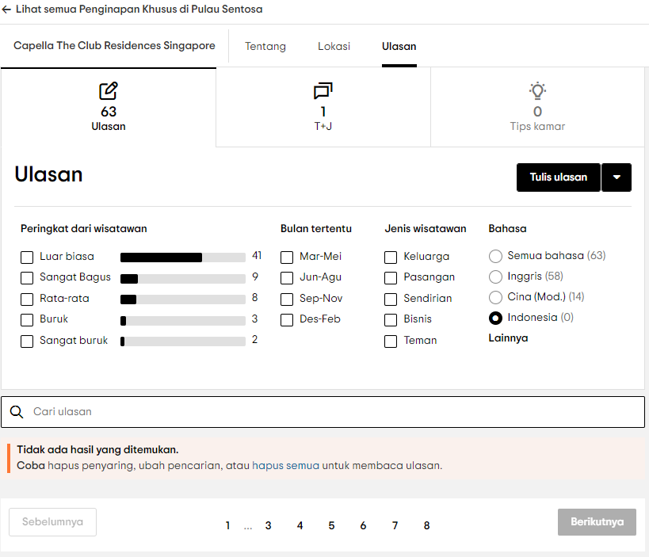
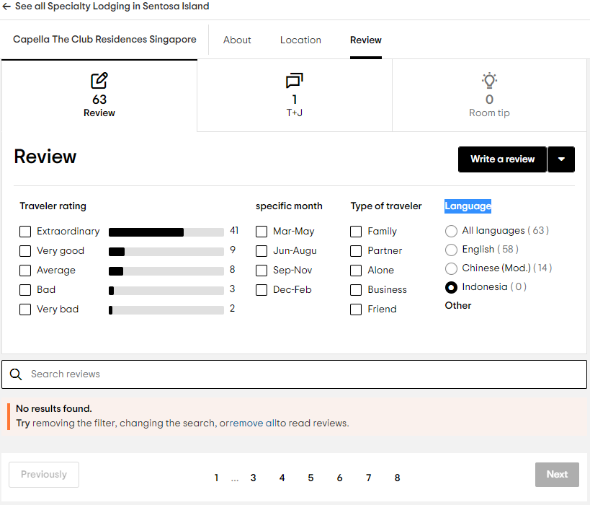
TripAdvisor reviews are predominantly not originally in Bahasa Indonesia (only 0.2%)
Notes:
Week 9: 11am Thu 19th May 2022 as instructed by Team I/C

Slide 68
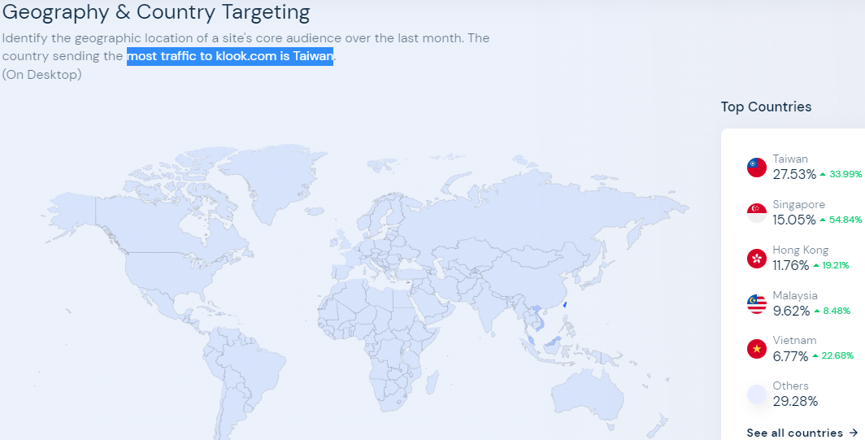
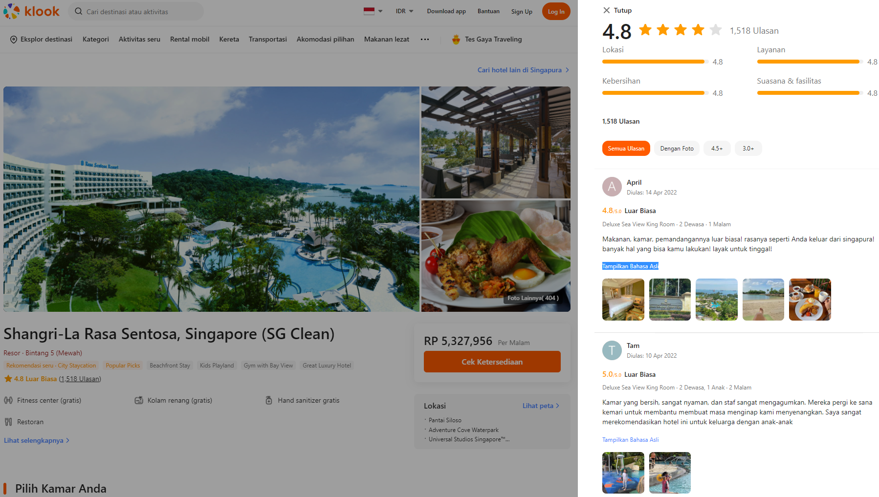
‘Tampilkan Bahasa Asli’ translates as ‘Show Native Language’
Notes:
Week 6: 11am Thu 28th April 2022 as requested by Team I/C

Slide 69
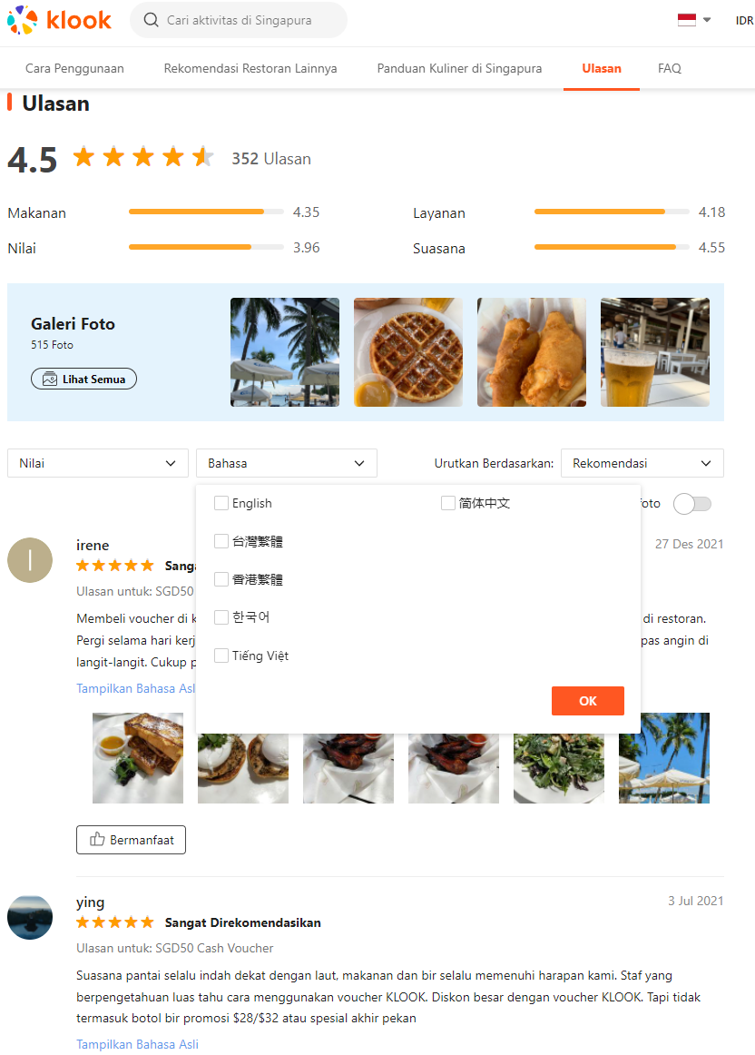
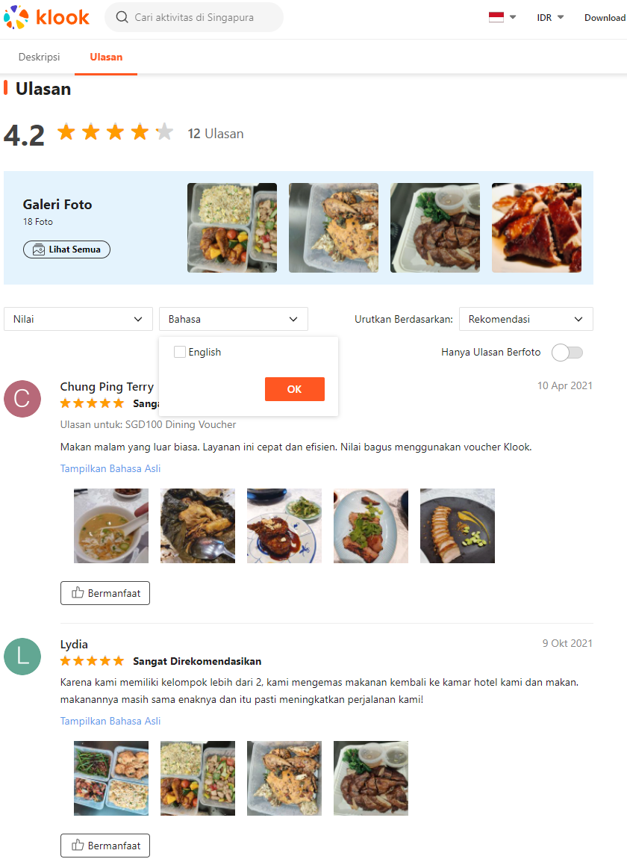
Bahasa Indonesia not listed in the original review languages
‘Show Native Language’
Notes:
‘Region / Country’ set to ‘Indonesia’ Currency set to ‘IDR’

Slide 70
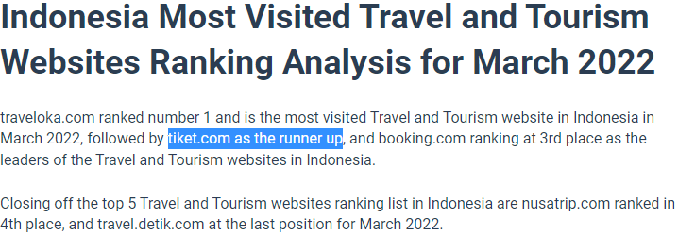
 | Attractions | Indo 2018-2022 | Dining | Indo 2018-2022 | Hotel | Indo 2018-2022
Traveloka | 13.7% | 2,042 | - | - | 3,302 | 3.5%
Google |  | 2,049 | 29,645 | 0.3% | 23,721 | 0.4%
TripAdvisor | 0.4% | 244 | 13,666 | 0.0878% | 28,263 | 0.0142%
Klook | 0.3% | 543 | 14,366 | 0% | 8,927 | 0%
Tiket | 94 | - | - | - | 22 | 40.9%
Notes:
Lack of support in Natural Language Processing (NLP) for Bahasa Indonesia and dataset are the key roadblocks in this group project

Slide 71
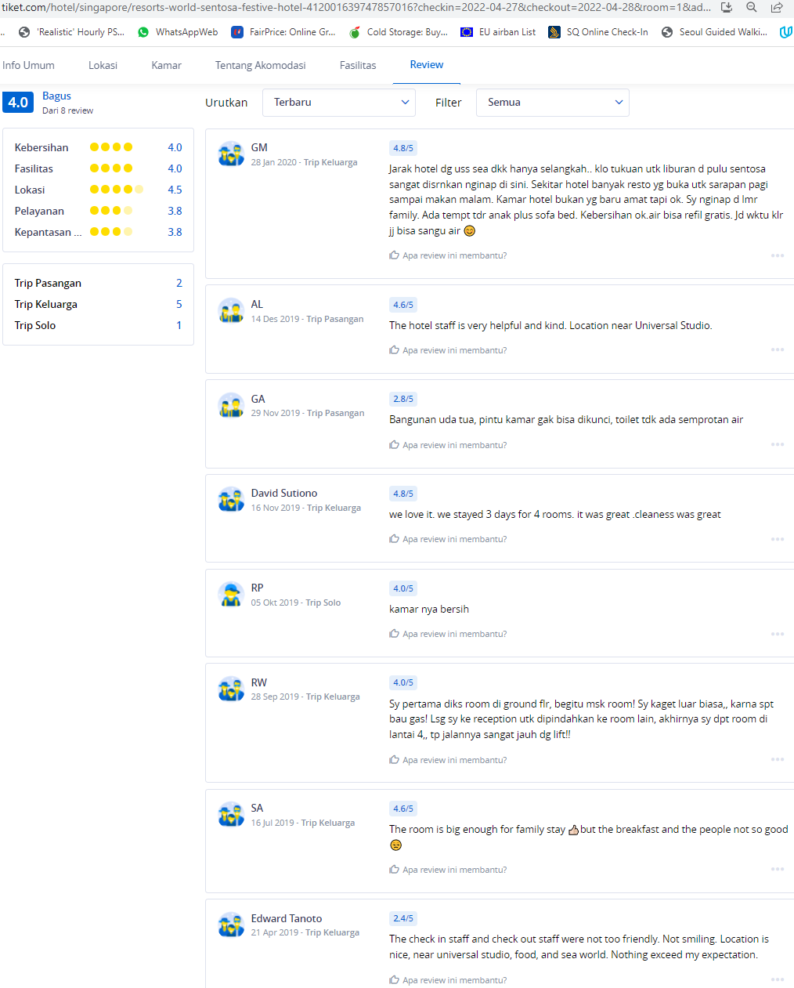
https://www.tiket.com/hotel/ singapore/area/sentosa-island
Notes:
Only 3 Sentosa hotels got reviews online Tiket: 1) Festive RWS, 2) Siloso Beach Resort, & 3) ShangriLa Rasa

Slide 72
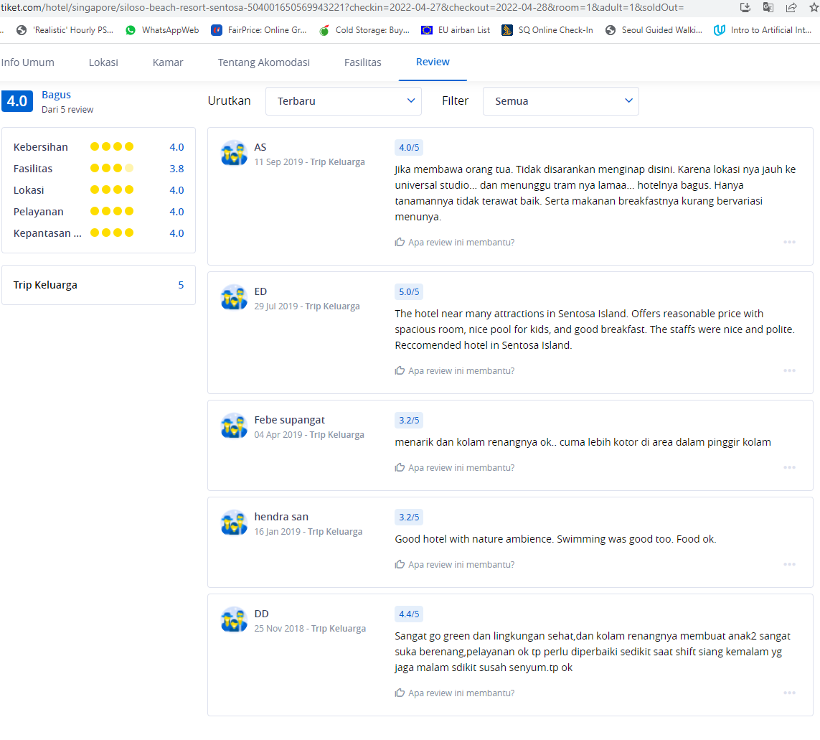
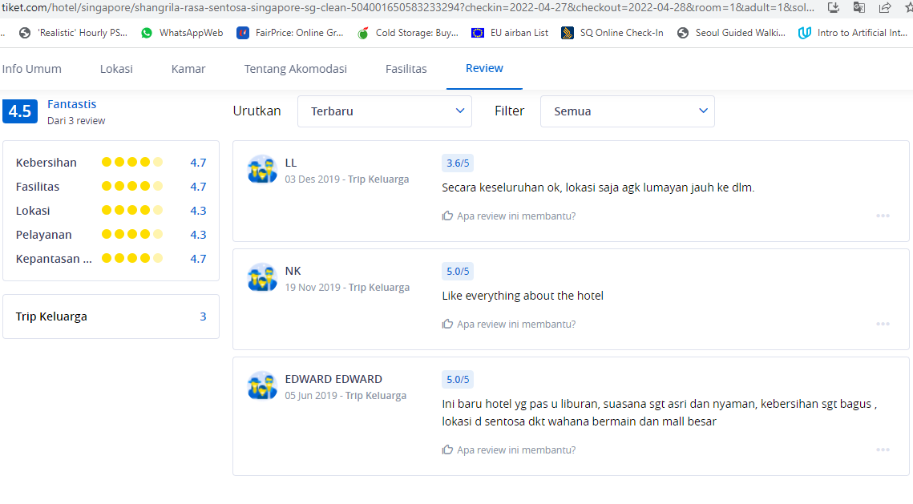
Notes:
Sentosa hotel reviews online Tiket are highly probable Indonesians but those written in ‘inggris’ are excluded in this group project to fulfil SDC specific instruction for local native NLP. They can be included if it’s based on Indonesia visitors regardless of their language.

Slide 73
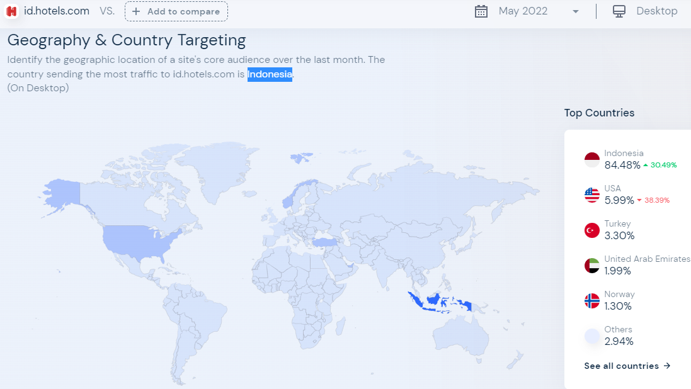

Booking.com also doesn’t have any hotel/dining reviews originally in Bahasa Indonesia
Notes:
The few Indonesian reviews were beyond our date range

Slide 74
Sentosa Hotels
Bahasa Indonesian 2018 – May 2022
Notes:
Details emailed in PDF & excel spreadsheets (7 tabs) for Week 11: 11am Thu 02nd June 2022 SDC engagement session

Slide 75
#1 Siloso Beach Resort 43 #2 Festive RWS 38 #3 Michael RWS 28 #4 Hard Rock® Hotel 26
Jan-May
only 5 months
Notes:
0 Indonesia reviews for 5 Sentosa Hotels (out of total 21 listed online): 1] Barracks Hotel Sentosa, 2] Club Residences @ The Knolls, 3] Glamping, 4] TreeTop Lofts, & 5] Ocean Suites RWS

Slide 76
Traveloka Hotel Reviews (as of 2022 May) |  | Bahasa Indonesia |  | 2018-2022
TOTAL | 3,302 | 8.96% | 296 | 117 | 3.54%
1) Amara Sanctuary Resort Sentosa | 267 | 4.87% | 13 | 4 | 1.50%
2) Beach Villas | 11 | 36.36% | 4 | 0 | 0%
3) Club Residences @ The Knolls | 1 | 0% | 0
4) Capella Singapore | 7 | 28.57% | 2 | 1 | 14.29%
5) Crockfords Tower | 3 | 33.33% | 1 | 1 | 33.33%
6) Equarius Hotel™ | 507 | 5.33% | 27 | 5 | 0.99%
7) Festive Hotel™ | 289 | 13.49% | 39 | 19 | 6.57%
8) Hard Rock® Hotel Singapore | 252 | 10.32% | 26 | 14 | 5.56%
9) Hotel Michael | 681 | 4.99% | 34 | 11 | 1.62%
10) Oasia Resort Sentosa | 173 | 19.65% | 34 | 13 | 7.51%
11) ONE°15 Marina Sentosa Cove Singapore | 228 | 4.82% | 11 | 2 | 0.88%
12) Shangri-La Rasa Sentosa Singapore | 323 | 4.02% | 13 | 6 | 1.86%
13) Siloso Beach Resort | 414 | 15.94% | 66 | 29 | 7%
14) Sofitel Sentosa | 79 | 7.59% | 6 | 4 | 5.06%
15) Barracks Hotel Sentosa | 5 | 60% | 3 | 0 | 0%
16) Outpost Hotel Sentosa | 11 | 36.36% | 4 | 0 | 0%
17) Village Hotel Sentosa | 11 | 72.73% | 8 | 6 | 54.55%
18) W Hotel Sentosa | 40 | 12.5% | 5 | 2 | 5%
Notes:
Even though Siloso Beach Resort has the most Indonesia reviews online Travelok for Sentosa hotel during 2018-2022, Village Hotel Sentosa has the largest percentage fulfilling this group project criteria (Noted for possible data analysis output bias)

Slide 77
Translation | TOP WORDS | Frequency | 2018 | 2019 | 2020 | 2021 | 2022
https://databasic.io/en/wordcounter/ | Word counter | 5,069 | 1,466 | 3,000 | 470 | 63 | 72
hotel | hotel | 138 | 37 | 86 | 14 | 1
room | kamar | 92 | 36 | 50 | 4 |  | 2
good | bagus | 81 | 34 | 34 | 10 | 3
close | dekat | 53 | 19 | 30 | 4
comfortable | nyaman | 53 | 15 | 26 | 9 | 1 | 2
peace | sentosa | 50 | 16 | 28 | 6
pool | kolam | 44 | 9 | 29 | 5 | 1
swimming | renang | 43 | 10 | 27 | 5 | 1
no | tidak | 43 | 15 | 23 | 4 |  | 1
clean | bersih | 38 | 13 | 16 | 4 | 1 | 4
child | anak | 36 | 6 | 25 | 5
stay overnight | menginap | 34 | 9 | 21 | 2 |  | 2
the place | tempatnya | 34 | 17 | 10 | 4 | 1 | 2
okay | oke | 33 | 13 | 12 | 7 |  | 1
we | kami | 32 | 10 | 21 | 1
service | pelayanan | 29 | 12 | 14 | 2 | 1
friendly | ramah | 29 | 15 | 14
beach | pantai | 27 | 8 | 12 | 6 |  | 1
breakfast | sarapannya | 27 | 8 | 17 | 2
the room | kamarnya | 26 | 11 | 12 | 1 |  | 2
facility | fasilitas | 25 | 7 | 16 | 2
family | keluarga | 25 | 6 | 12 | 6 | 1
singapore | singapura | 25 | 7 | 12 | 5 | 1
location | letak | 24 | 9 | 12 | 3
again | lagi | 23 | 6 | 15 | 1 |  | 1
nice | enak | 22 | 11 | 11
universal | universal | 22 | 6 | 14 | 2
Translation | TOP WORDS | Frequency | 2018 | 2019 | 2020 | 2021 | 2022
large | luas | 21 | 13 | 5 | 2 |  | 1
same | sama | 21 | 2 | 19
many | banyak | 19 | 6 | 10 | 3
the food | makanannya | 19 | 4 | 13 | 2
studio | studio | 19 | 6 | 12 | 1
time | waktu | 19 | 6 | 11 | 1 |  | 1
enough | cukup | 18 | 8 | 9 | 1
not enough | kurang | 18 | 9 | 8 | 1
water | air | 17 | 2 | 13 | 2
holiday | liburan | 17 | 5 | 9 | 2 | 1
pleasant | menyenangkan | 17 | 4 | 13
view | pemandangan | 17 | 6 | 9 | 1 | 1
uss | uss | 17 | 5 | 10 | 2
free | gratis | 16 | 6 | 8 | 2
night | malam | 15 | 2 | 12 | 1
his | nya | 15 | 6 | 7 | 1 |  | 1
like | seperti | 15 | 4 | 6 | 5
every | setiap | 15 | 1 | 13 |  |  | 1
staff | staf | 15 | 10 | 5
bus | shuttle | 14 | 7 | 6 | 1
Notes:
Translation from the native language in Bahasa Indonesia to English is only done at the end strictly just to understand the output.
All textual analysis is processed in its original form with minimal pre-processing necessitated to reduce lose in accuracy. (Week 6: 11am Thu 28th April 2022)
Noticeable Trend: ‘bersih‘ (clean) is mentioned FOUR (4) times in 2022’s six (6) reviews (67%) compared to SIXTEEN (16) times out of 2019’s 89 hotel reviews in Bahasa Indonesian (18%)
2020-2022: Service / Friendly / Pleasant / Staff disappeared
Swimming / Pool 30% in 2019 / Child 28% in 2019 / Family 13% 2019 : significant reduction

Slide 78
Translation | BIGRAMS | Frequency |  | Translation | TRIGRAMS | Frequency
swimming pool | kolam renang | 24 |  | very close to | sangat dekat dengan | 6
close to | dekat dengan | 23 |  | to universal studio | ke universal studio | 5
this hotel | hotel ini | 19 |  | resort world sentosa | resort world sentosa | 5
universal studio | universal studio | 15 |  | close to universal | dekat dengan universal | 5
comfortable and | nyaman dan | 13 |  | with universal studio | dengan universal studio | 5
staying at | menginap di | 13 |  | one of the hotels | salah satu hotel | 5
the hotel | hotel yang | 13 |  | universal studio and | universal studio dan | 4
that room | kamar yang | 12 |  | in this hotel | di hotel ini | 4
vivo city | vivo city | 12 |  | good hotel | hotel yang bagus | 4
the swimming pool | kolam renangnya | 11 |  | stay here | menginap di sini | 4
which is very | yang sangat | 11 |  | on sentosa island | di sentosa island | 4
at the hotel | di hotel | 11 |  | room on the floor | kamar di lantai | 4
at peace | di sentosa | 10 |  | vivo city and | vivo city dan | 4
to universal | ke universal | 9 |  | on the 2m floor | di lantai 2m | 4
shuttle bus | shuttle bus | 9 |  | hard rock hotel | hard rock hotel | 4
good and | bagus dan | 9 |  | and close to | dan dekat dengan | 3
clean and | bersih dan | 9 |  | shuttle bus for | shuttle bus untuk | 3
and comfortable | dan nyaman | 8 |  | and universal studio | dan universal studio | 3
very good | sangat bagus | 8 |  | for family and | untuk keluarga dan | 3
here | di sini | 7 |  | very close to | dekat sekali dengan | 3
Notes:
Named Entity Recognition (NER) in SpaCy pipeline (with Wikipedia QID) requires additional pre-training thus was not effective to extract keywords for filtering irrelevant social media data (Week 7: 11am Thu 05th May 2022) n-gram (Bi-gram/Tri-gram) extracts efficiently: e.g. ‘Swimming Pool’, ‘Universal Studio’, ‘Shuttle Bus’
‘Resort Word Sentosa’, ‘Good hotel’, ‘Hard Rock Hotel’
VivoCity not located at Sentosa but it’s closely related as ‘the Gateway to Sentosa’

Slide 79

2022 (only 6 Indonesian reviews from Google with 72 words)
Notes:
Annual word clouds show how the Sentosa hotel trend shifted with the Indonesia visitors

Slide 80

2021 (word clouds translated from Indonesian to English for understanding)
Notes:
Translated from Indonesian to English for understanding of the output

Slide 81

2020 (Covid19 restrictions started in April)
Notes:
Face-mask wearing mandatory around mid-April 2020 with reduced global travel

Slide 82

2019 (Pre-Covid / normal tourism data)
Notes:
From rare to common: bigger size indicate higher frequency of word in Indonesia reviews
E.g. ‘Toilet’, ‘Casino’, ‘Bathroom’, ‘Breakfast’, ‘Restaurant’, ‘Strategic’, ‘Location’

Slide 83

2018
Notes:
Last part covers the Sentosa Dining’s data analysis

Slide 84
Sentosa F&Bs
Bahasa Indonesian 2018 – May 2022
Notes:
Week 14: 11am Tue 21st June 2022 as allocated by Team I/C

Slide 85

39 F&B listings with reviews originally in Bahasa Indonesian (out of 102 listed Dining available online) SDC full list 117
Notes:
Google Dining Indo: 1) Malaysian Food Street 20, 2) Good Old Days Food Court (HALAL) 8, 3) Hard Rock Café (American) 7, 6) Din Tai Fung RWS (Taiwan) 5, 6) Loui's NY Pizza Parlor Universal Studios 5, 6) Tanjong Beach Club (Seafood) 5, 7) Streats Asian Café RWS 3, 12) Arches Restaurant (Indian) 2, 12) Goldilocks Fried Chicken (Filipino) 2, 12) Putien (Chinese) 2, 12) McCafe (HALAL) 2, 12) McDonald's (HALAL) 2, 35) Blue Lotus Singapore Chinese Eating House 1, 35) Bones 'n Barrels Sentosa (Live Music Bar) 1, 35) Coastes @ Siloso Beach Walk (Bar) 1, 35) Coffee Bean and Tea Leaf (HALAL) 1, 35) eM By The Marina (Japanese) 1, 35) Feng Shui Inn (Cantonese) 1, 35) Fratelli Trattoria (Italian) 1, 35) Krispy Kreme Sentosa (HALAL) 1, 35) Marrybrown (Malaysian fast-food) 1, 35) Mambo Beach Club (Bar) 1, 35) Mel’s Drive-in RWS (American) 1, 35) Oasis Spice Café RWS (Indian) 1, 35) Ola Beach Club Siloso (Hawaiian) 1, 35) Royal Albatross Luxury Tall Ship RWS 000(Sunset Dinner Cruise) 1, 35) Rumours Beach Club (Bar) 1, 35) Silver Shell Café (Beach Buffet) 1, 35) Shutters Amara Sentosa (Fusion) 1, 35) SolePomodoro Trattoria Pizzeria (Italian) 1, 35) Starbucks Café 1, 35) Texas Chicken RWS 1, 35) ToastBox (Snack) 1, 35) Trapizza (Italian) 1
TripAdvisor Dining Indo: 1) Malaysian Food Street 3, 10) Din Tai Fung RWS (Taiwan) 1, 10) Good Old Days Food Court (HALAL) 1, 10) Hard Rock Café (American) 1, 10) Kitchen Table (European) 1, 10) Kwee Zeen (French) 1, 10) Starbot Café (Chinese) 1, 10) Stickhouse (Italian) 1, 10) The Knolls (European) 1, 10) McDonald's (HALAL) 1

Slide 86

>60% Sentosa Dining Indonesian Reviews 2018-May 2022 lands in the ‘Family’ zones with ‘Entertainment / Fun’
https://goo.gl/maps/w5eni27F9ToJof5N9
Notes:
with reference to ‘GIE Insights_18 Mar 2022.pdf’
6 of 8 (75%) Hard Rock Café (#3) reviews were given 5/5 (remaining 2 had 4/5)
Operating hours doesn’t seem to be a significant factor for Indonesians

Slide 87
Translation | TOP WORDS | frequency |  | Translation | bigram | frequency
food | makanan | 50 |  | Ms. Naomi | mbak naomi | 19
no | tidak | 37 |  | universal studio | universal studio | 15
eat | makan | 36 |  | food court | food court | 11
the place | tempat | 33 |  | dinner | makan malam | 9
nice | enak | 24 |  | food choices | pilihan makanan | 8
many | banyak | 22 |  | universal login | masuk universal | 6
we | kami | 21 |  | there isn't any | tidak ada | 6
service | pelayanan | 21 |  | fat rice | nasi lemak | 5
miss | mbak | 20 |  | naomi wu | naomi wu | 5
price | harga | 19 |  | a bit expensive | agak mahal | 4
naomi | naomi | 19 |  | peanut porridge | bubur kacang | 4
pass | berlalu | 18 |  | green beans | kacang ijo | 4
choice | pilihan | 17 |  | high ice | es teler | 4
the restaurant | restorannya | 17 |  | fast service | pelayanan cepat | 4
rice | nasi | 16 |  | lots of choices | banyak pilihan | 4
but | tapi | 16 |  | sentosa island | pulau sentosa | 4
studio | studio | 15 |  | Indonesian people | orang indonesia | 4
universal | universal | 15 |  | the ice cream | es krimnya | 3
come | datang | 14 |  | prata bread | roti prata | 3
because | karena | 14 |  | not friendly | tidak ramah | 3
like | seperti | 14
reasonable | lumayan | 13 |  | Translation | trigram | frequency
good | baik | 12 |  | enter universal studio | masuk universal studio | 6
from | dari | 12 |  | this food court | food court ini | 5
ok | deh | 12 |  | Ms. Naomi Wu | mbak naomi wu | 5
more | lebih | 12 |  | green bean porridge | bubur kacang ijo | 4
night | malam | 12 |  | Indonesian tongue | lidah orang indonesia | 4
good | bagus | 11 |  | dinner at | makan malam di | 3
court | court | 11 |  | lots of food choices | banyak pilihan makanan | 3
expensive | mahal | 11 |  | good but it seems | bagus tapi sepertinya | 3
friendly | ramah | 11 |  | looks like it needs more | sepertinya butuh lebih | 3
breakfast | sarapan | 11 |  | many tables and | banyak meja dan | 3
halal | halal | 10 |  | sit down so people | duduk supaya orang | 3
if | kalau | 10 |  | not fighting for a place | tidak berebut tempat | 3
time | kali | 10 |  | with fine cuisine | dengan masakan ala | 3
person | orang | 10 |  | Malaysian style food | masakan ala malaysia | 3
star | bintang | 9 |  | great choice of food | banget pilihan makanan | 3
delicious | enak2 | 9 |  | this is too crowded | ini plg ramai | 3
cool | mendinginkan | 9 |  | for lunch | untuk makan siang | 3
the staff | stafnya | 9 |  | AC room | ruangan ber ac | 3
chicken | ayam | 8 |  | good for cooling | lumayan buat mendinginkan | 3
cleanliness | kebersihannyaa | 8 |  | the staff don't understand | stafnya tidak mengerti | 3
Notes:
https://en.wikipedia.org/wiki/Indonesian_cuisine
https://journalofethnicfoods.biomedcentral.com/articles/10.1186/s42779-019-0009-3

Slide 88

Notes:
https://en.wikipedia.org/wiki/Islam_in_Indonesia “Indonesia is the most populous Muslim-majority country, with approximately 231 million adherents. 86.7% of the Indonesian population practise Islam (99% Sunnis, 1% Shias and 0.2% Ahmadis) in a 2018 survey. Rice (nasi) is central to the lives of Indonesians. …often has Middle Eastern and Indian influences, featuring curried meat such as chicken or beef, fish, and vegetables … with some hint of Chinese influence”
#3 India (10.9%) 195,000,000 Muslims (2022 population 1,406,632) 14.2%
#24 Malaysia (1.1%) 16,318,355 Muslims (2022 population 33,181) 61.3%
#88 Singapore (0.04%) 781,558 Muslims (2022 population 5,944) 14.7%

Slide 89
Grouping the Sentosa F&Bs that the Indonesian visitors wrote reviews for 2018-May 2022
Asian (27%) - Malaysian Food Street (23) - Streats Hong Kong Café RWS (3) | HALAL (17%) - Good Old Days Food Court (9) - McDonald's (3) - McCafe (2) - Coffee Bean and Tea Leaf (1) - Krispy Kreme Sentosa (1) - Texas Chicken RWS (1) | AMERICAN (10%) - Hard Rock Café (8) - Starbucks (1) - Mel’s Drive-in RWS (1) | ITALIAN (10%) - Loui’s NY Pizza Parlor Universal Studios (5) - Fratelli Trattoria (1) - SolePomodoro Trattoria Pizzeria (1) - Trapizza (1) - Stickhouse (2)
TAIWAN (6%) Din Tai Fung RWS (6) | SEAFOOD (5%) Tanjong Beach Club (5) | CHINESE (4%) - Putien Restaurant (2) - Starbot Café (1) - Blue Lotus Singapore Chinese Eating House @ Sentosa Cove (1) | INDIAN (3%) - Arches Restaurant (2) - Oasis Spice Café RWS (1)
BAR (3%) - Bones 'n Barrels Sentosa (1) - Mambo Beach Club (1) - Coastes @ Siloso Beach Walk (1) | EUROPEAN (2%) - Kitchen Table at W Singapore Sentosa Cove (1) - The Knolls (1) | FAST-FOOD (2%) - MarryBrown (1) - Toast Box Café RWS (1) | Filipino (2%) Goldilocks Fried Chicken USS (2)
FRENCH (1%) Kwee Zeen (1) | FUSION (1%) Shutters Amara Sentosa (1) | Hawaiian (1%) Ola Beach Club Siloso (1) | INDONESIAN (1%) Rumours Beach Club (1)
JAPANESE (1%) eM By The Marina (1) | Cantonese (1%) Feng Shui Inn (1) | BEACH BUFFET (1%) Silver Shell Café (1) | SUNSET DINNER CRUISE (1%) Royal Albatross Luxury Tall Ship RWS (1)
Notes:
Only 1 out of the 98 Indonesia reviews for Sentosa Dining were rated 1/5: Good Old Days Food Court 2019 March TripAdvisor
On a typical scale of 1 – 5 for usual online ratings, 1=BAD 5=Perfect is 3=Neutral? But computer only process numbers so 3/5 = 60% NOT just pass 50%
10% of the Indonesia reviews for Sentosa Dining rated below 80%:
TripAdvisor 2020 Malaysian Food Street & 2019/03 McDonald
Google 2018 Arches Indian Restaurant, 2019 Malaysian Food Street & Loui's NY Pizza Parlor Universal Studios, 2020 McCafe / McD / Oasis Spice Café RWS (Indian) & Shutters Amara Sentosa (Fusion)

Slide 90

Non-Halal ≠ deal-breaker as long there’s chicken
Notes:
McCafe + Krispy Crème + Stickhouse Italian Gelato: No chicken option Halal (15) Chicken (36) Pork (22) Alcohol (21) Fine-Dining (2)

Slide 91

>91% Indonesia visitors rated above 80% for #1 Sentosa F&B in this dataset
Notes:
Malaysian Food Street: 65.22% of data from 2019 15x 5* (3 each in 2020 & 2018) 65.22%
6x 4* (1 from 2018 & 3 in 2019) 26.1%

Slide 92

Word cloud translated for 10 reviews rated 3/5 & below
Notes:
Neither ‘PRICE’ nor ‘EXPENSIVE’ in the top words for low ratings

Slide 93


https://goo.gl/maps/uGcjxbKtYbMATKdH7
2020 (Data collected 2022 May) Covid19 restriction started April 2020
Level 7 (out of 10) https://support.google.com/local-guides/answer/6225851?hl=en
Notes:
Number of characters (including spaces): 1728
Number of characters (without spaces): 1412
Number of words: 276
Number of sentences: 20
Number of syllables: 603

Slide 94
Non-English Native Local Languages Textual Data Analysis 100 days 14 weeks
SDC GIE NLP
Data Analytics / Data Architecture & Engineering / Corporate Planning
Nvidia
Vincent Tang / Timothy Liu
China
Simplified Chinese
India
Mixture of 121 +270
Indonesia
Bahasa Indonesian
Malaysia
Bahasa Melayu
Republic Polytechnic
Seow Khee Wei /Koay Seng Tian
Artificial Intelligence
School of Infocomm
Social Media
Kelvin Thor
Travel Reviews
Traveloka / Tiket / TripAdvisor / Google / Klook
Twitter
Sentiment Analysis
Hotels
F & B
Gina Ng
Attractions
Alfred / Odelia / Luqman
Fri 18th March 2022
Notes:
Members can update one-liner of their work scope if to branch out an additional layer in overview

Slide 95
#4 Odelia Tan
Using Part of Speech to extract Meaningful Keywords

Slide 96
What is Part of Speech?
Part of speech indicates how the word functions in meaning as well as grammatically within the sentence
An individual word can function as more than one part of speech when used in different circumstances
Understanding parts of speech is essential for determining the correct definition of a word when using the dictionary
Eight Part of Speech (POS) in the English language: noun, pronoun, verb, adjective, adverb, preposition, conjunction, and interjection

Slide 97
Stanza by Stanford NLP
Uses neural pipeline
Provides pretrained NLP models for a total of 66 human languages including Indonesian, Chinese(simplified), Chinese(traditional), Tamil and Telugu
Uses Universal Dependencies (UD) models, which are trained on the UD treebanks

Slide 98
Universal Part of Speech Tags
ADJ: adjective
ADP: adposition
ADV: adverb
AUX: auxiliary
CCONJ: coordinating conjunction
DET: determiner
INTJ: interjection
NOUN: noun
NUM: numeral
Source: https://universaldependencies.org/u/pos/
PART: particle
PRON: pronoun
PROPN: proper noun
PUNCT: punctuation
SCONJ: subordinating conjunction
SYM: symbol
VERB: verb
X: other

Slide 99
Adjective
An adjective is a word used to modify or describe a noun or a pronoun
The young girl asked her mother to bring her to the beach at Sentosa for a picnic and then she quickly hid under the blanket. Wow!

Slide 100
Adverb
An adverb describes or modifies a verb, an adjective, or another adverb
It usually answers the questions of when, where, how, why, under what conditions, or to what degree
Adverbs often end in –ly
The young girl asked her mother to bring her to the beach at Sentosa for a picnic and then she quickly hid under the blanket. Wow!

Slide 101
Noun
A noun is the name of a person, place, thing or idea
The young girl asked her mother to bring her to the beach at Sentosa for a picnic and then she quickly hid under the blanket. Wow!

Slide 102

How does Stanza Annotate?

Slide 103
Unigrams
Part of Speech | Indonesian | English
Adjectives | puas lama nak murah panas ampun keren lengkap luas nyaman | satisfied long nice inexpensive hot sorry cool complete Large comfortable

Slide 104
Bigrams
Part of Speech | Indonesian | English
Adverb + Adjective | sangat lengkap sangat nyaman cukup mahal lebih baik terlalu besar kadang jengkel juga bersih sangat bagus juga enak lebih seru | very complete very comfortable quite expensive better too big sometimes annoyed also clean very good also delicious more fun

Slide 105
Trigrams
Part of Speech | Indonesian | English
Adverb + Adjective + Noun Noun + Adverb + Adjective | paling seru transformer sangat spektakuler tempat sangat wow tempat kurang pas anak sangat bersih disini paling keren 3d lumayan mahal tempat sagat bagus tempat sangat rekomended pengalaman lumayan moderen pertunjukan | the most exciting transformer very spectacular place very wow place not fitting for children very clean here the coolest 3d pretty expensive place really good place very recommended experience pretty modern show

Slide 106

Code to get Bigrams

Slide 107

Code to get Trigrams

Slide 108
#5 Alfred Tan
Topic Modeling and Labeling
Notes:
All details were presented weekly & emailed 2022 March 21st till end-June

Slide 109


Aim to achieve: Topic Modeling and Labeling
Extract unique topics, together with keywords that best describe these topics.
Platform where actual reviews associated with unique topics can be read.
Tool to filter and summarize reviews posted publicly.
Categorize and put label on every review in text corpus.
Analyze and extract out key insights from what visitors talk about Sentosa the most.
Notes:
Has animation. Quickly run through scope.
Bahasa Indonesia was chosen

Slide 110


Topics Extraction using TOP2VEC
Notes:
Explain areas on internet that has user feedback

Slide 111


Topics Extraction using TOP2VEC
Notes:
Explain areas on internet that has user feedback

Slide 112


Notes:
Explain areas on internet that has user feedback

Slide 113

Build and Apply Functions to Construct ‘Topics’ Dataframe
Notes:
Explain areas on internet that has user feedback

Slide 114

Manually Label the Topics
Notes:
Explain areas on internet that has user feedback

Slide 115


Label the Master-List Dataframe
Notes:
Explain areas on internet that has user feedback

